Slide 1
The West of England :
An Introduction
Steven Knaggs – Senior Claims Manager
Mondayday 12th September 2022

Slide 2
Brief history of marine insurance
Concept of mutuality
Evolution of the West of England
The Club now

Slide 3
“Look at the swell. You'll not find a bigger swell anywhere. It has half the globe for its run-up. You're young. You have the whole world. Don't bother yourself with the past.”

Slide 4
A brief history of Marine Insurance

Slide 5
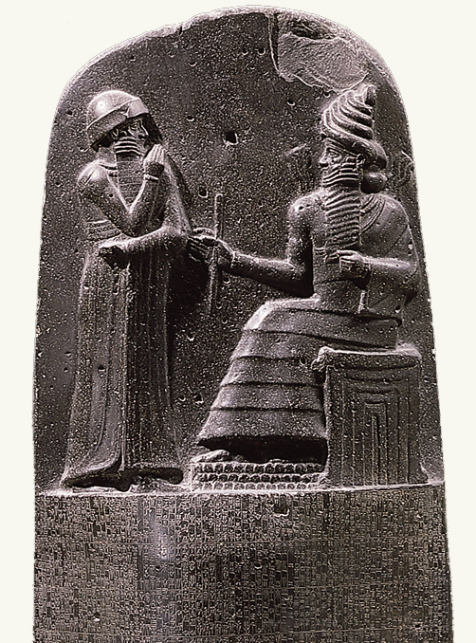
Marine Insurance – 1st Rules
1750BC – Code of Hammurabi
If a man rents his boat to a sailor, and the sailor is careless, and the boat is wrecked or goes aground, the sailor shall give the owner of the boat another boat as compensation.
If a man hires a sailor and his boat, and provides it with grain, clothing, oil and dates, and other things of the kind needed for fitting it, and the sailor is careless, the boat is wrecked, and its contents ruined, then the sailor shall compensate for the boat which was wrecked and all in it that he ruined.

Slide 6
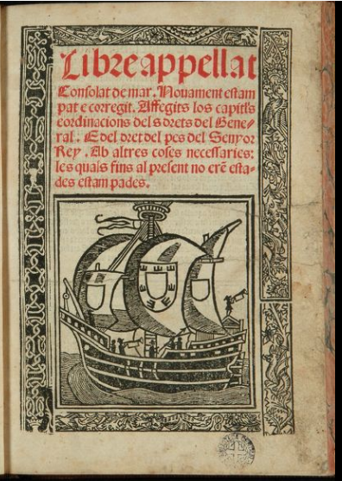
Marine Insurance – European Developments
7th Century – Lex Rhodia
“The loss of one was divided among several”
1260 - Libre Consolat de Mar of Barcelona
Commercial code of maritime legislation of the Mediterranean
1265 - The Rules of Oleron
… pieces of the hulk of the vessel, as well as the lading thereof, ought to be reserved …

Slide 7
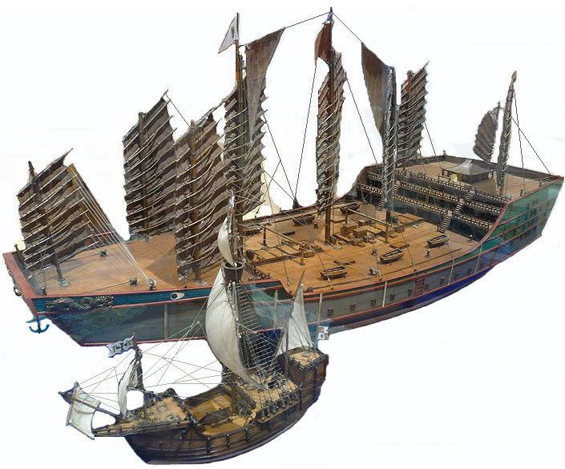
Marine Insurance – Chinese advancements?
c.1420 - Admiral Zheng He ship
1492 Columbus’ SANTA MARIA

Slide 8
Marine Insurance – London’s Origins
1574 Queen Elizabeth I grants permission to establish an insurance office in the Royal Exchange Building for the preparation and registration of insurance policies
1601 England passed its first legislation dealing with insurance describing it as
“An Act Concerning Matters of Assurances Amongst Merchants” (Merchants’ Assurances Act 1601):
  “By means of which Policies of Assurance it cometh to pass upon the loss or perishing of any ship, there followeth not the undoing of any Man, but the loss lighteth rather easily upon many than heavily upon a few”

Slide 9
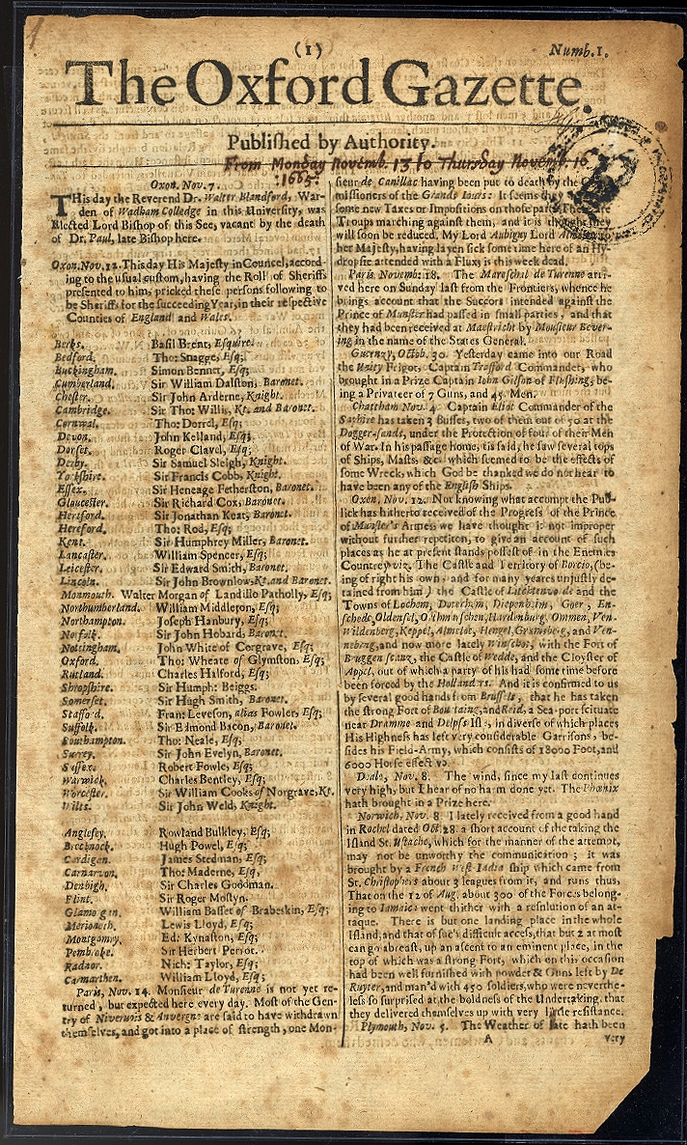
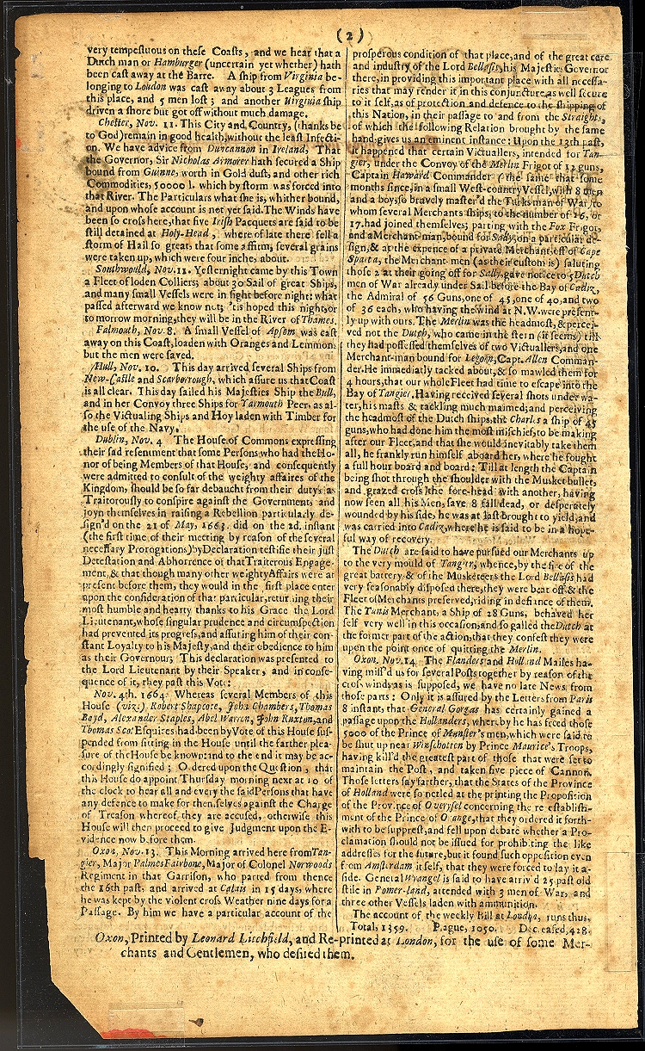
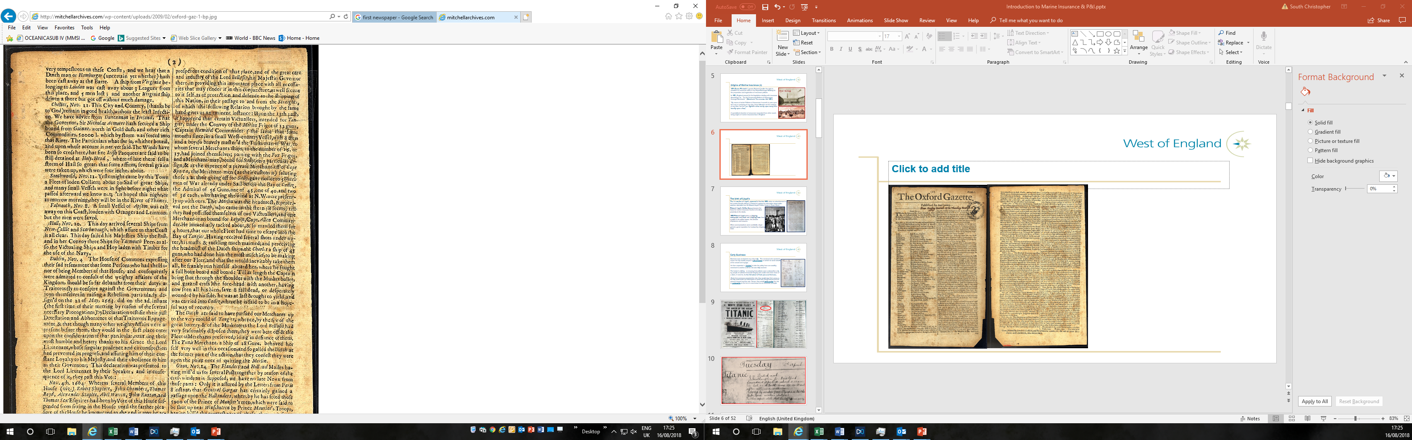
Marine Insurance – London’s Origins
1655 Shipping news in a very early newspaper

Slide 10
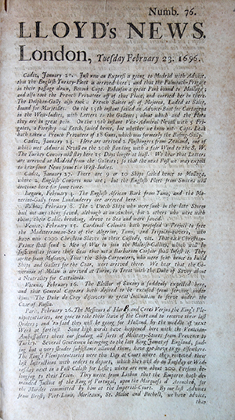
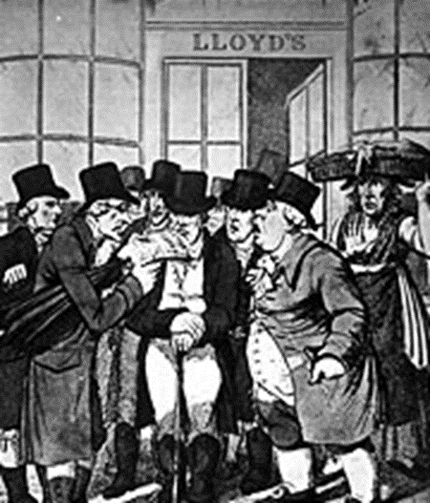
Marine Insurance – The birth of Lloyd’s
The 1st mention of Lloyd’s appeared in the late 1680s when an advertisement in the London Gazette offered “a reward of a guinea for information about stolen watches claimable from Mr Edward Lloyd’s Coffee House in Tower Street, close to the London docks.
1688 Edward Lloyd started a shipping newspaper and attracted
shipowners and insurers by reading out shipping news from a
pulpit in his coffee house.
When communications were unreliable, Lloyd gained a great
reputation for trustworthy shipping news

Slide 11
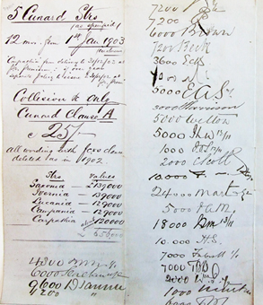
Marine Insurance – The birth of Lloyd’s
The merchant who wanted to insure his ship would prepare a slip of
paper on which he wrote details of the vessel and voyage. He then
requested a ‘broker’ to take the policy from one wealthy merchant
to another until the risk was fully covered.
The broker’s skill lay in ensuring that policies were underwritten only by
people of sufficient financial integrity who could meet their share of a
claim, if need be, to the full extent of their personal fortunes.
Each time someone accepted the risk, they would sign their name on
the slip underneath the description of what was being insured and the
amount insured and the rate, i.e. they would write under the risk,
or underwrite the risk, as the term is now known.

Slide 12
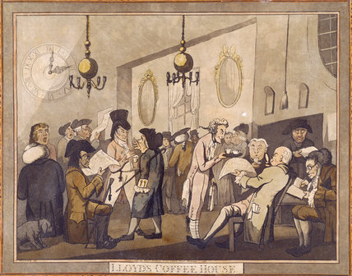
Marine Insurance - The birth of Lloyd’s
As Lloyd’s Coffee House had the people wanting to place risks for their shipping and the market for people who would offer insurance, it soon become recognised as the place for obtaining marine insurance
In 1769, a number of Lloyd’s more reputable customers decided to break away and set up a rival establishment and properly constituted society in the ‘New Lloyd’s Coffee House’
In 1774, they moved to the Royal Exchange while still referring to being ‘Lloyd’s Coffee House’.

Slide 13
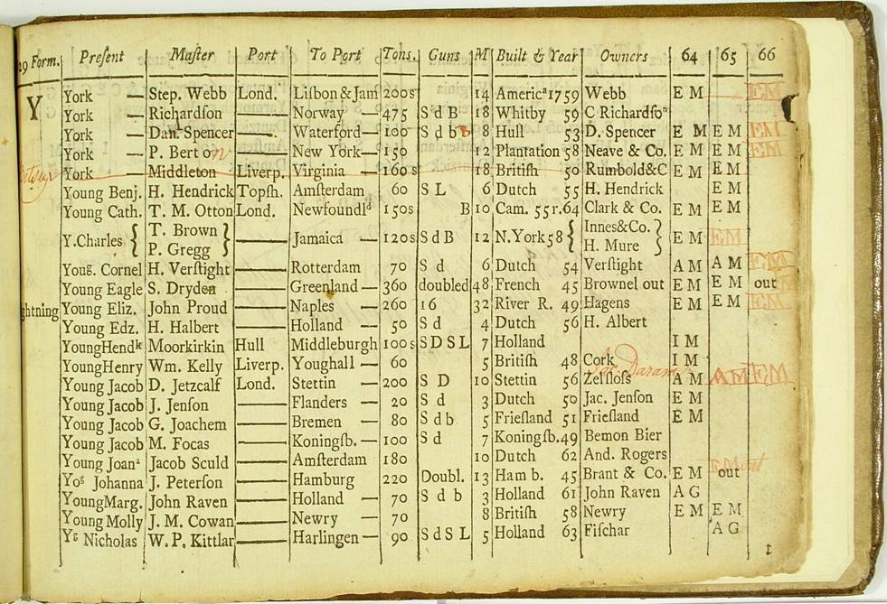
Marine Insurance - Lloyds Register of Ships
Earliest surviving register 1764
Records 4,118 vessels across 16 UK ports
Records past and present names of the vessel, the name of the master, the number of crew, the names of the owners, the number of guns carried, when and where the ship was built and the classification given

Slide 14
Marine Insurance – Legislation
Marine Insurance Act 1745
"the first significant statutory intervention in substantive marine insurance law“
Marine Insurance Act 1788
Introduced transparency into insurance contracts
Marine Insurance Act 1906
Brought everything together and more (e.g. Uberrimae Fides)

Slide 15
“We don't sail because the sea is there. We sail because there's a harbour. We don't start by heading for distant shores. We seek protection first.”

Slide 16
Concept of Mutuality

Slide 17

Principles of Mutuality
Shared risks between ship owner members
Shared risks between International Group Clubs
Members are both Insurers & Insured
Assets owned by Members
Non-profit-making / non-loss-making
(Supplementary Calls - Reduced Calls - Return Calls)

Slide 18

Balance of Mutuality
“Cost Price”
Claims
Costs and Expenses
Reinsurance Premiums
Operating Costs
Premiums
Investments
R/I Recoveries

Slide 19
“Two drowning people can’t save each other. All they can do is drag each other down.”

Slide 20
Evolution of the West of England

Slide 21
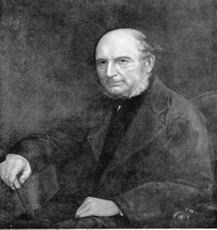
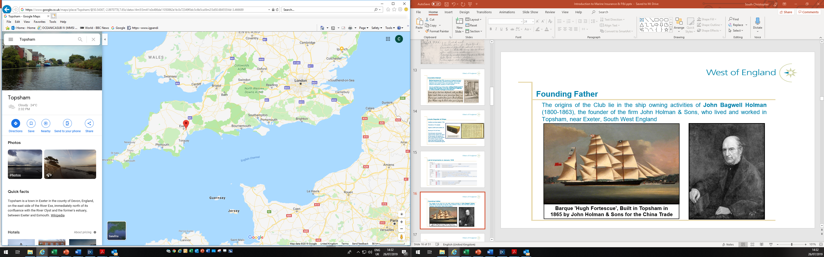
Once upon a time…
The origins of the Club lie in the ship owning activities of John Bagwell Holman (1800-1863), the founder of the firm John Holman & Sons, who lived and worked in Topsham, near Exeter, southwest England

Slide 22
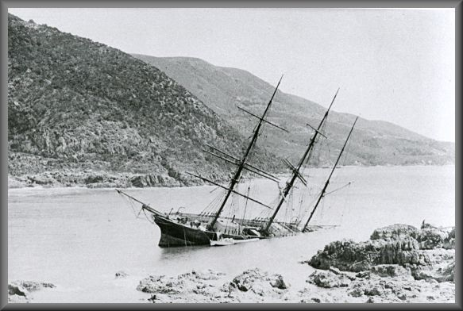
Advent of mutual hull insurance
In early 19th C. Ship owners were confronted with the problem of insuring their ships.
Since 1720 (The Bubble Act) only 2 companies allowed outside Lloyds to provide marine insurance: Royal Exchange Assurance & London Assurance.
The limited insurance market took advantage of distance from owners and near monopolistic opportunities with high premiums.
In 1832, Exeter ship owners formed the West of England Marine
Insurance Association to provide at cost hull insurance.
Members contributed to a mutual non-profit making fund which cost considerably less than insurance provided by Lloyds & the two company underwriters.

Slide 23
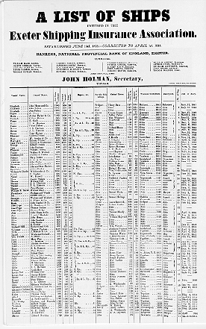
A second hull mutual…
In 1838 the Exeter Shipping Insurance Association was formed also providing mutual hull insurance for West Country ship owners.
John Holman was the Secretary of this new Mutual.
By 1854, the firm of John Holman & Sons managed the insurance of over 500 vessels

Slide 24
Changing risks : 3rd Party Liabilities
Lloyd’s underwriters began to write hull risks competitively but would not take on the increasing burden of 3rd party liabilities facing ship owners:
“De Vaux v Salvador” (1836) : English court ruled that an ordinary policy against perils of the sea did not cover damage done to another vessel in a collision - leaving owners exposed...
Fatal Accidents Act 1846 : dependents of persons whose lives lost at sea through improper navigation able to sue ship owners – age of mass migrations to N America & Australia…
1847 Harbour Docks and Piers Causes Act : gave harbour authorities the right to recover for damages irrespective of negligence

Slide 25
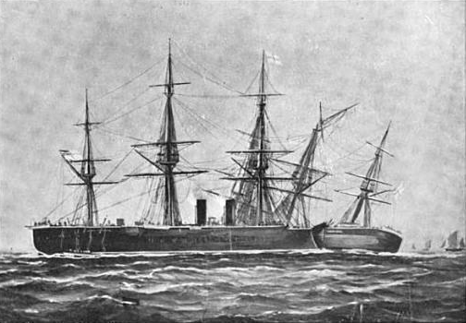
Changing risks : 3rd Party Liabilities
Hull underwriters only prepared to cover ¾ of collision liability.
Underwriters believed that shipowners would take greater care in the safe navigation of their vessels if they had to bear a substantial part of the risk themselves - particularly since the Master was often a shareholder in the ship at that time

Slide 26
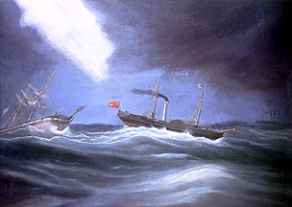
1855 : The First Indemnity Mutual
John Bagwell Holman decided to fill the insurance gap and created “The Ship Owners Protection Association”. Managers: John Holman & Sons.
The Association started with 221 vessels and a tonnage of 58,228 - all from local ship owners
Followed principles of earlier Hull Clubs with Members
paying into a mutual non-profit making fund
The Britannia Club was also founded in 1855 and actually 1st to trade.

Slide 27
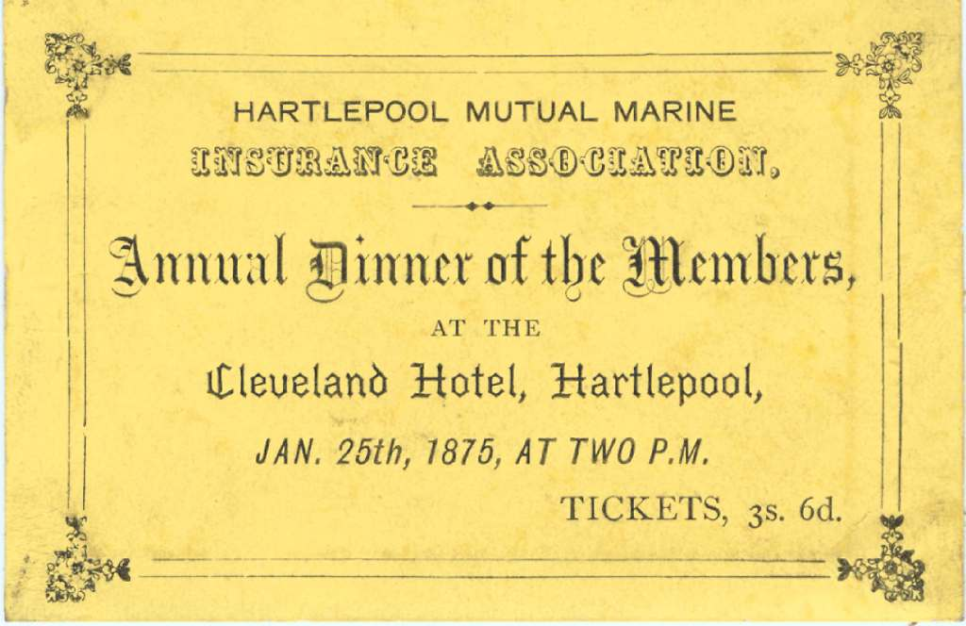
Spread of Marine Mutuals
Other mutual Associations formed by regional ship owners included:
Devon Mutual Steamship Insurance Association Exmouth Marine Insurance Association
Teignmouth and General Mutual Shipping Association Global Marine Insurance Society
Shoreham Mutual Marine Insurance Associations Marine Mutual Insurance Association
Total Loss Mutual Steamship Insurance Company Trinity Mutual Marine Insurance Club
Hartlepool Mutual Marine Insurance Association
Hull Steam Trawlers Mutual Insurance and Protecting Co
Mutuals also started in Scandinavia, Netherlands

Slide 28
Cargo liability
Traditionally, freedom of contract meant owners could exclude all liability to cargo
Shipping cargo by sea was seen as a known dangerous risk
Liability to Cargo cover was therefore not initially included in the Rules of new Protection Mutuals
All change : The “WESTERHOPE” (1870)

Slide 29
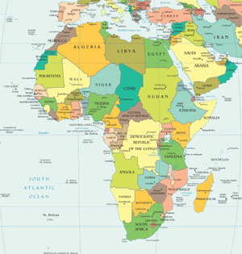
Cargo liability
The “WESTERHOPE” (1870)
Vessel bound for Cape Town but went first to Port Elizabeth and was then lost
The court decided that the shipowner was not protected by the exceptions in the contract of carriage due to committing a deviation and held that they were liable for full value of the cargo.
The shipowner attempted to present his indemnity claim for consideration by the directors of the protection club but was turned down since the club did not cover such cargo risks.
Cape Town Port Elizabeth

Slide 30
Rise of Indemnity Clubs and merging into P&I
Stanley Mitcalfe was an underwriter with an insurance company in Newcastle and wrote an article focusing on a wide range of potential liabilities shipowners might have towards cargo owners and underwriters.
He formed a new club in 1874 the Steamship Owners’ Mutual providing insurance for these potential cargo liabilities, it was called an 'Indemnity Club’.
Other similar Indemnity Clubs were soon formed.
The first true 'P&I Clubs’ were formed by amalgamation of an 'Indemnity Club' and a 'Protection Club’ providing a very comprehensive cover on shipowners' liability.
J Stanley Mitcalfe

Slide 31
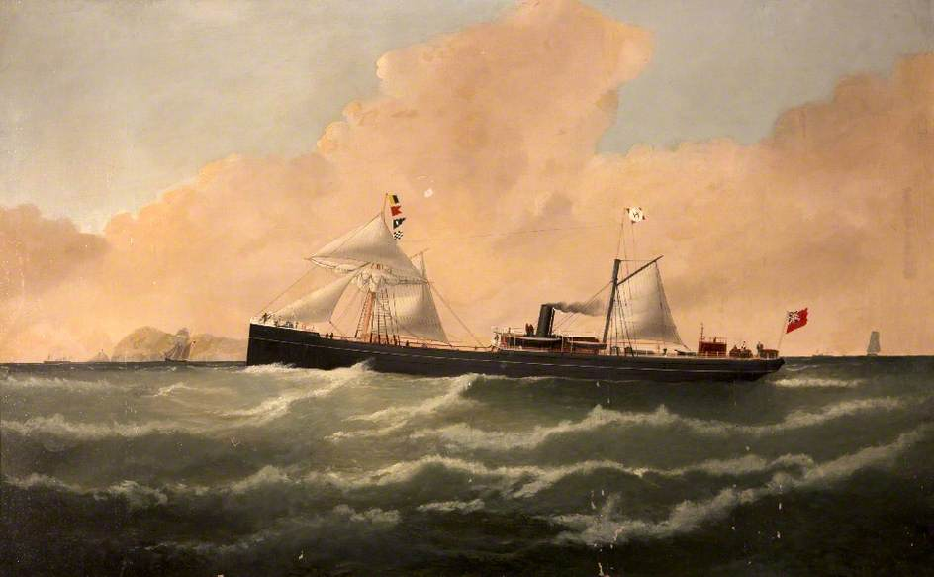
A new P&I Club
1870 : The West of England Steamship Owners’ P&I Association Ltd
Shipping was changing with steam ships increasing domination of world trade
Dedicated entirely to third party liabilities of steam powered vessels
Managed by John Holman & Sons
Screw-Powered Schooner ‘CITY OF EXETER', Built in 1870 for John Holman & Sons

Slide 32
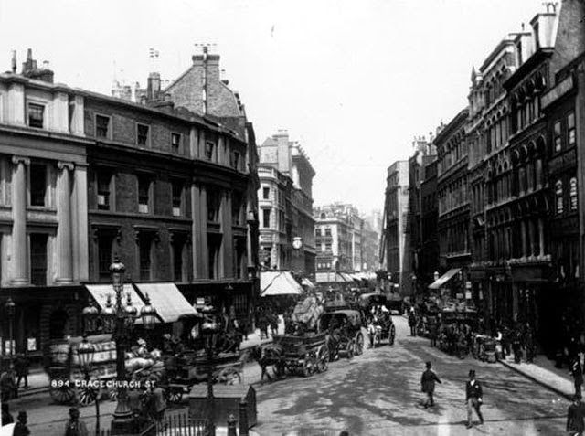
The move to London
1873 : John Holman & Sons moved both the Shipowners and West of England Clubs and their management to Lime Street in City of London
West of England was one of the first Clubs to accept foreign ship owners as members

Slide 33


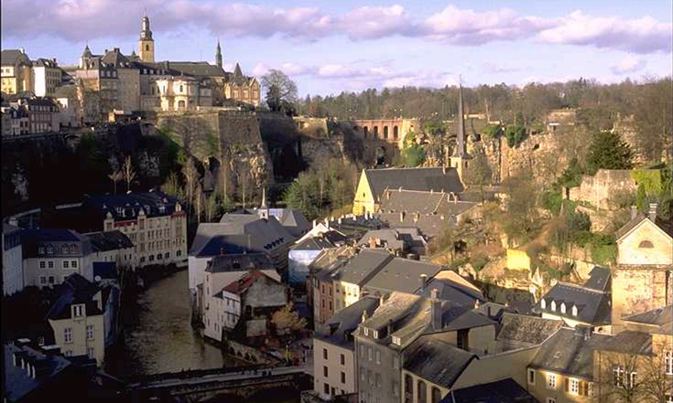
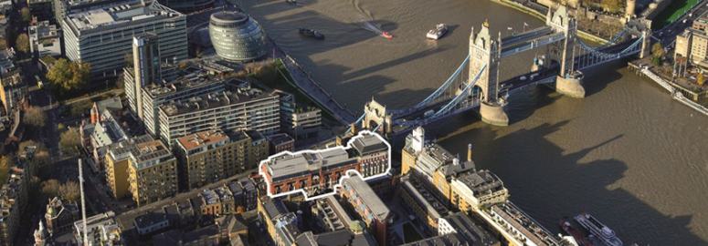
The Management Company
1955 : the management was transferred from John Holman & Sons to a wholly owned subsidiary company in London.
1969 : the P&I business was transferred to the West of England Ship Owners Mutual Protection & Indemnity Association (Luxembourg) S.A. [shortened in 1980s to West of England Ship Owners Mutual Insurance Association (Luxembourg) S.A.]
1993 : the Management Company moved to Tower Bridge Court on the south side of the Thames, opposite the City of London

Slide 34
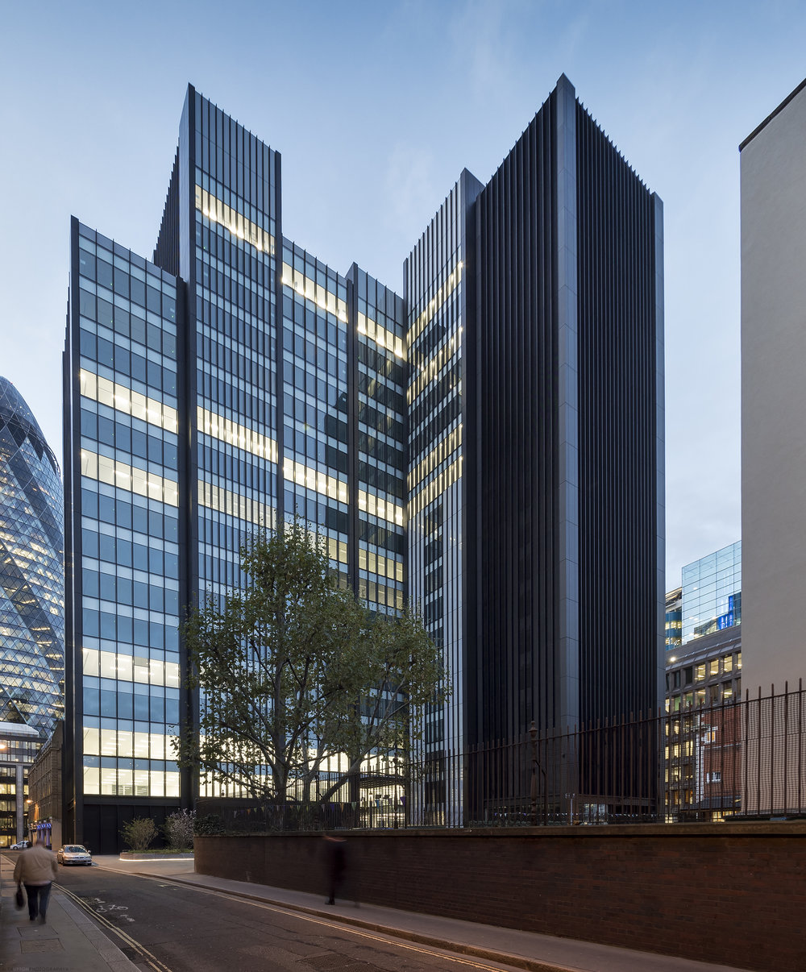
The Management Company
2005 : Management Company was registered in Luxembourg as:
West of England Insurance Services (Luxembourg) S.A.
2019 : Management Company moved back into the City, to One Creechurch Place.

Slide 35
“At first we insured only small ships and then … we took big vessels too. … the Marine Insurance Company acquired its own building. The building served the same function as the breakwater: it protected us.”

Slide 36
The West of England today

Slide 37

WEST Philosophy : Commercial Integrity
First class service
Value added benefit from high quality advice
Proactive loss prevention
Fair underwriting for all Members
Financial stability with strong reserves
Controlled growth without diluting existing capital and reserves

Slide 38
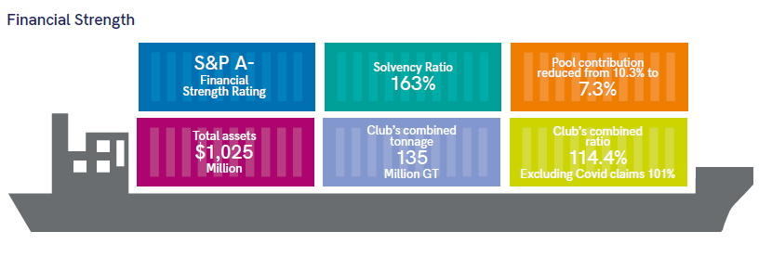
Market Strength

Slide 39
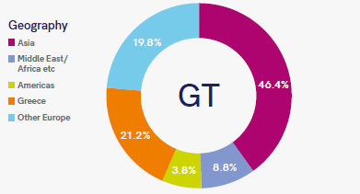

Slide 40
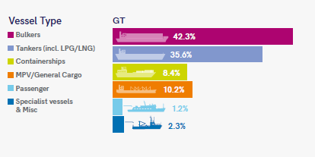
Diverse Membership

Slide 41
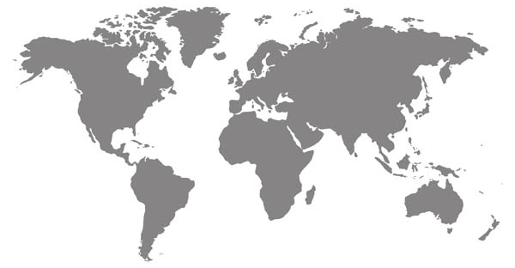


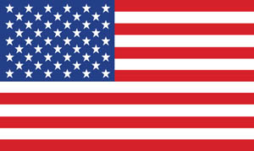

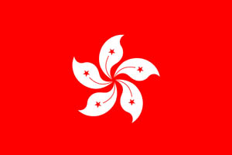
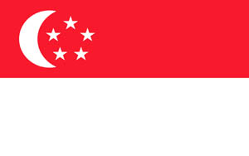
Global Office Network
London
Luxembourg
New York
Piraeus
Hong Kong
Singapore

Slide 42
Structure: Overview
The West of England Ship Owners Mutual Insurance Association (Luxembourg)
[Luxembourg office]
West of England Insurance Services
(Luxembourg) SA
[Head office London]
International Shipowners Reinsurance
Company SA
West of England Reinsurance
(Hamilton) Ltd
(Bermuda)
West of England Insurance Services (Luxembourg) SA
[Hong Kong Office]
West of England Insurance Services (Luxembourg) SA
[Singapore Office]
West of England (Hellas) Ltd
[Piraeus]
West of England Insurance Services (North America) Inc
[New York]

Slide 43
Structure: Overseas
Luxembourg
Where the Club is registered.
Deals with the reporting and regulatory function of the Club and its accounts, co-ordinates investment activity and manages the Club’s assets.
General Manager : Olivier Le Bescond
Piraeus
No Underwriting or Loss Prevention Depts.
Deals with the Club’s Greek members.
CEO: Ian Clarke
Hong Kong
Full service office with Claims, Underwriting and Loss Prevention Departments.
Deals with Far East-based members eg: in China and Vietnam.
Resident Directors:
Richard Macnamara (MD & Underwriting)
Quentin Drew (Claims).
Singapore
Works with Hong Kong office. Claims and Underwriting Departments.
Deals with the Club’s Singapore and SE Asia members.
CEO: Malcolm Pedley
New York
No Underwriting or Loss Prevention Depts.
Deals with the Club’s American members.
Manager: Paul Barnes

Slide 44
Structure: London
CEO
Tom Bowsher
CLAIMS
Suzanne Byrne
UNDERWRITING
Simon Parrott
FINANCE
Francis Corrigan
CORPORATE AFFAIRS & IG REPRESENTATION
Tony Paulson
LOSS PREVENTION
Simon Hodgkinson
Americas Team
Eastern Team
European Team
Correspondents
Audit & Compliance
HR
IS
Administration

Slide 45
Correspondents
Steve Knaggs – Correspondent Manager

Slide 46
“It doesn’t matter whether you live in a big town or a small one. Even if you live on the tiniest island in the middle of the ocean, as long as you have a telegraph, you’re at the centre of the world”

Slide 47
What is a Correspondent?
Independent and trusted companies / individuals on standby to assist the Club and its Members
The “Book” or “List”
Over 1500 listed correspondents across the International Group
Over 450 listed by WEST

Slide 48
Correspondent – What’s in a name?
Correspondents are NOT agents
Delegated authority to act on behalf of the Club on specific matters
No general authority (implied or actual) to bind the Club
Informal relationship which is understood and respected around the world

Slide 49
Appointment Criteria
4 Criteria the Club looks at :
  Quality of personnel and understanding of P&I
  Resources / Network available to the correspondent
  Conflict with P&I objectives
  Cost

Slide 50
Terms of Appointment
No contract
Invited annually to be listed but can be removed at any time
Remuneration
  Do the costs relate to an incident covered by the Club?
  Paid to be paid
  Has the Club been notified promptly of the incident?
Compliance
  GDPR
  Anti-Bribery
  Cyber Awareness
IG Guidelines for Correspondents

Slide 51
Club Management of Correspondents
The Club maintains control over instructions and monitors performance
IG Correspondent Subcommittee
Internal Audit
Visits

Slide 52
Future of Correspondents
Changing Role
  No longer acting alone
  Closer co-operation with international lawyers and experts
  Direct access to surveyors
  Advancement of technology
Diversification
  Agents
  Surveyors
  Lawyers
Experience
  P&I Qualification

Slide 53
Thank you
Steve Knaggs

