Slide 1
Salvage & Wreck Removal
Enam Hussain - Head of Claims, Eastern Team
Tim Davies - Senior Claims Manager, Eastern Team
London 14 September

Slide 2
Contents
Part 1 - Salvage - Tim Davies
Part 2 – Wreck Removal - Enam Hussain

Slide 3
Part I
Towage or Salvage?
Towage Forms
Salvage Forms
LOF and who contributes
Where the Club fits in – Liabilities
SCOPIC
Claims from Cargo/General average

Slide 4
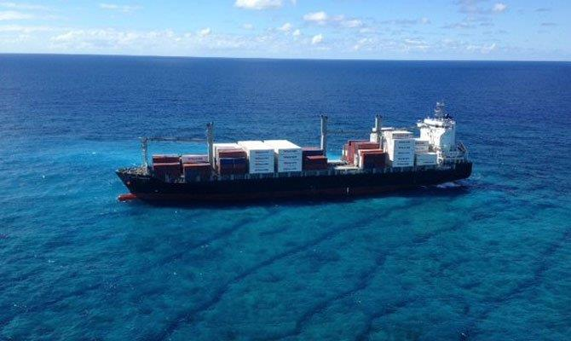
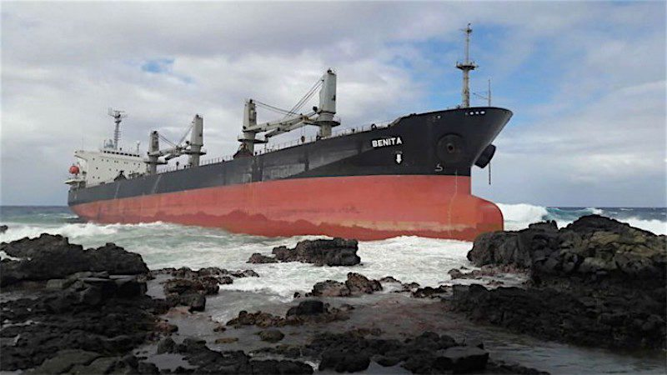
An Incident occurs
Towage or salvage?

Slide 5
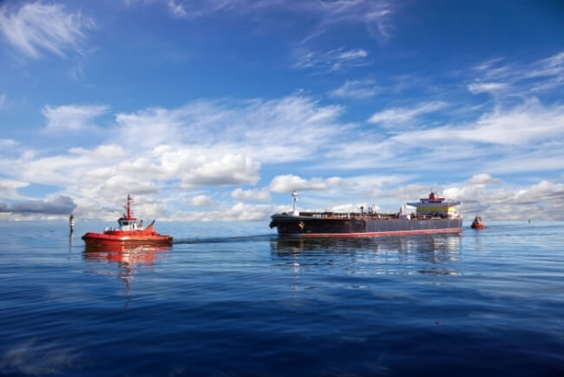
Towage

Slide 6
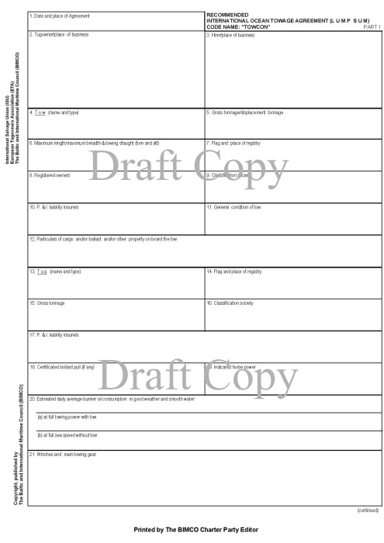
Towage - Contracts
Towcon

Slide 7
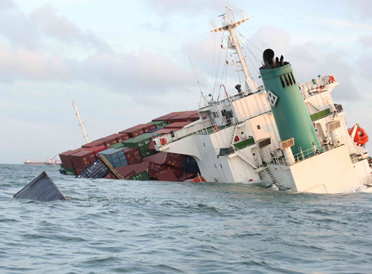
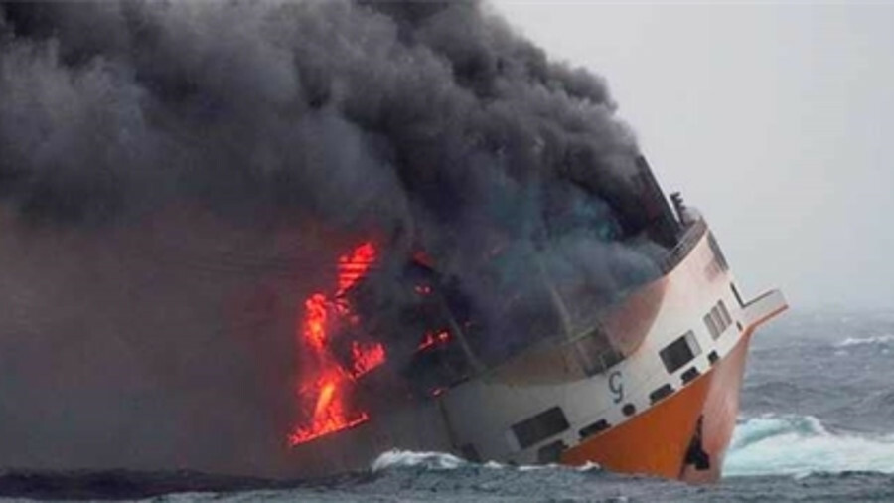
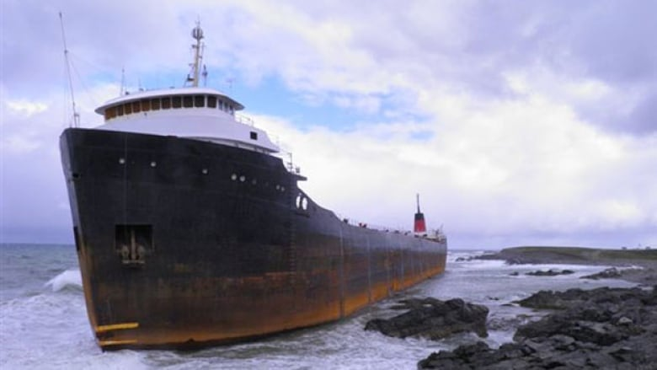
Salvage

Slide 8
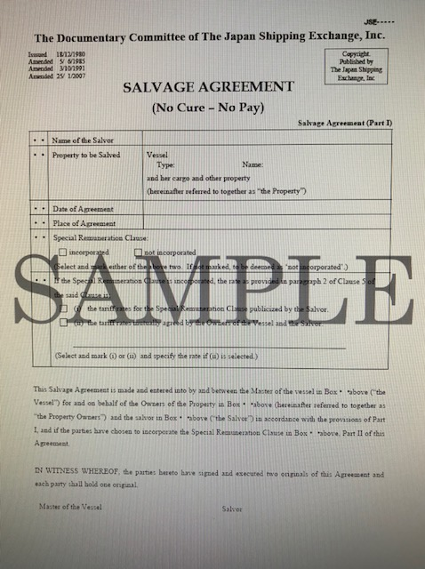
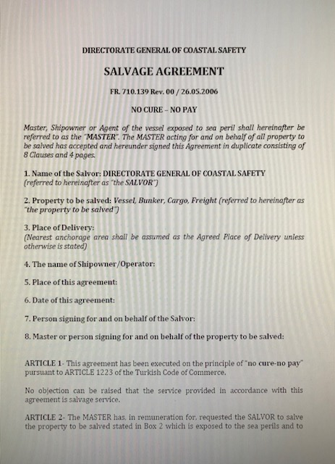
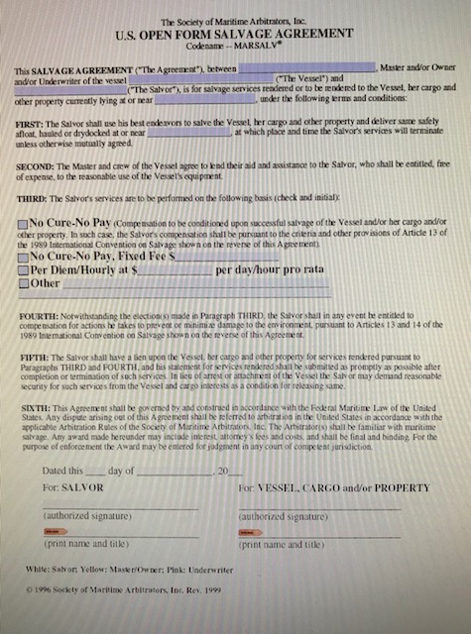
Salvage - Contracts

Slide 9
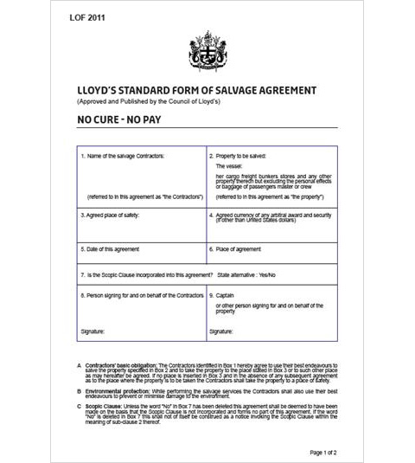
Salvage - Contracts
LOF
Lloyds Open Form
No Cure No Pay

Slide 10
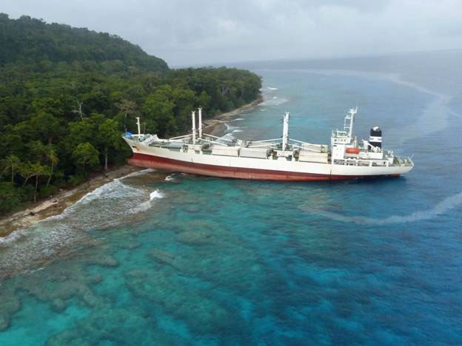
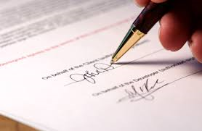
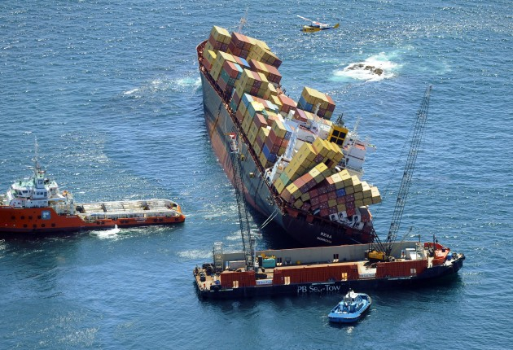
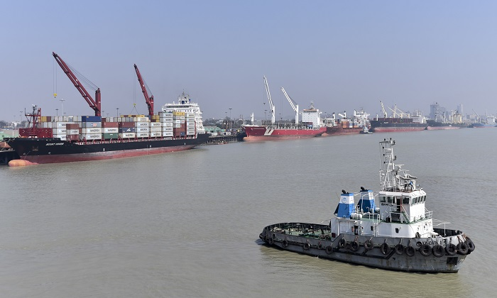
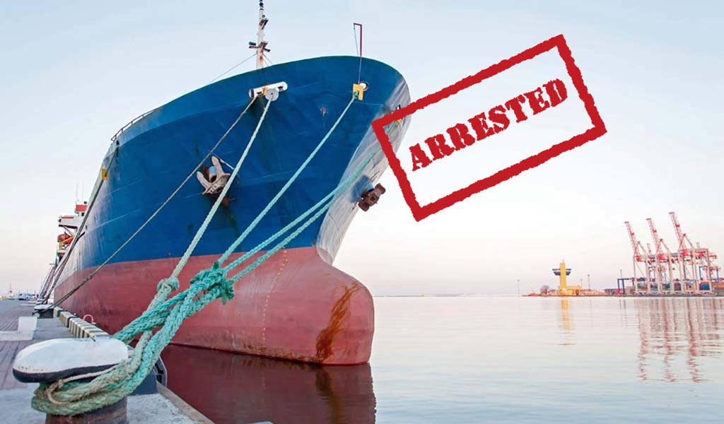

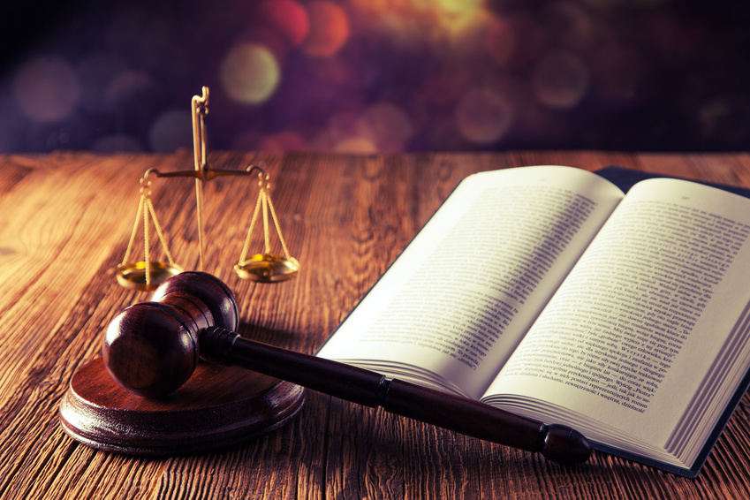

Salvage - Procedure

Slide 11
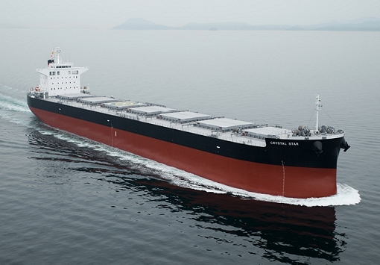
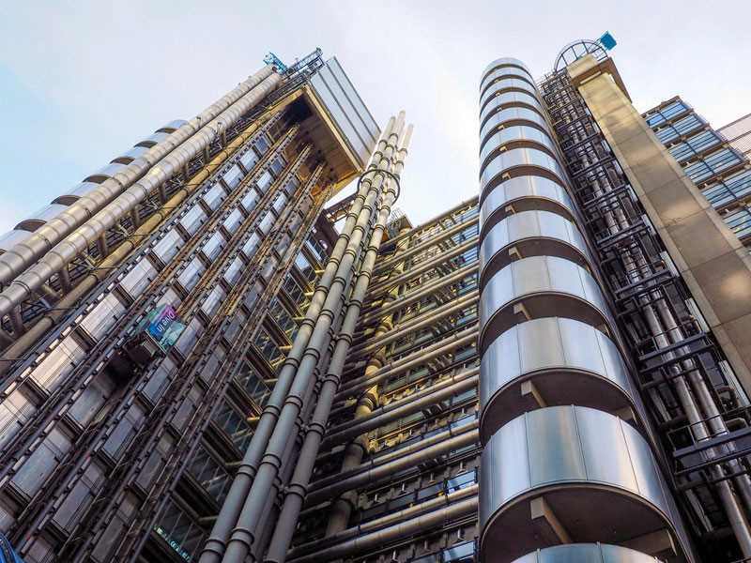
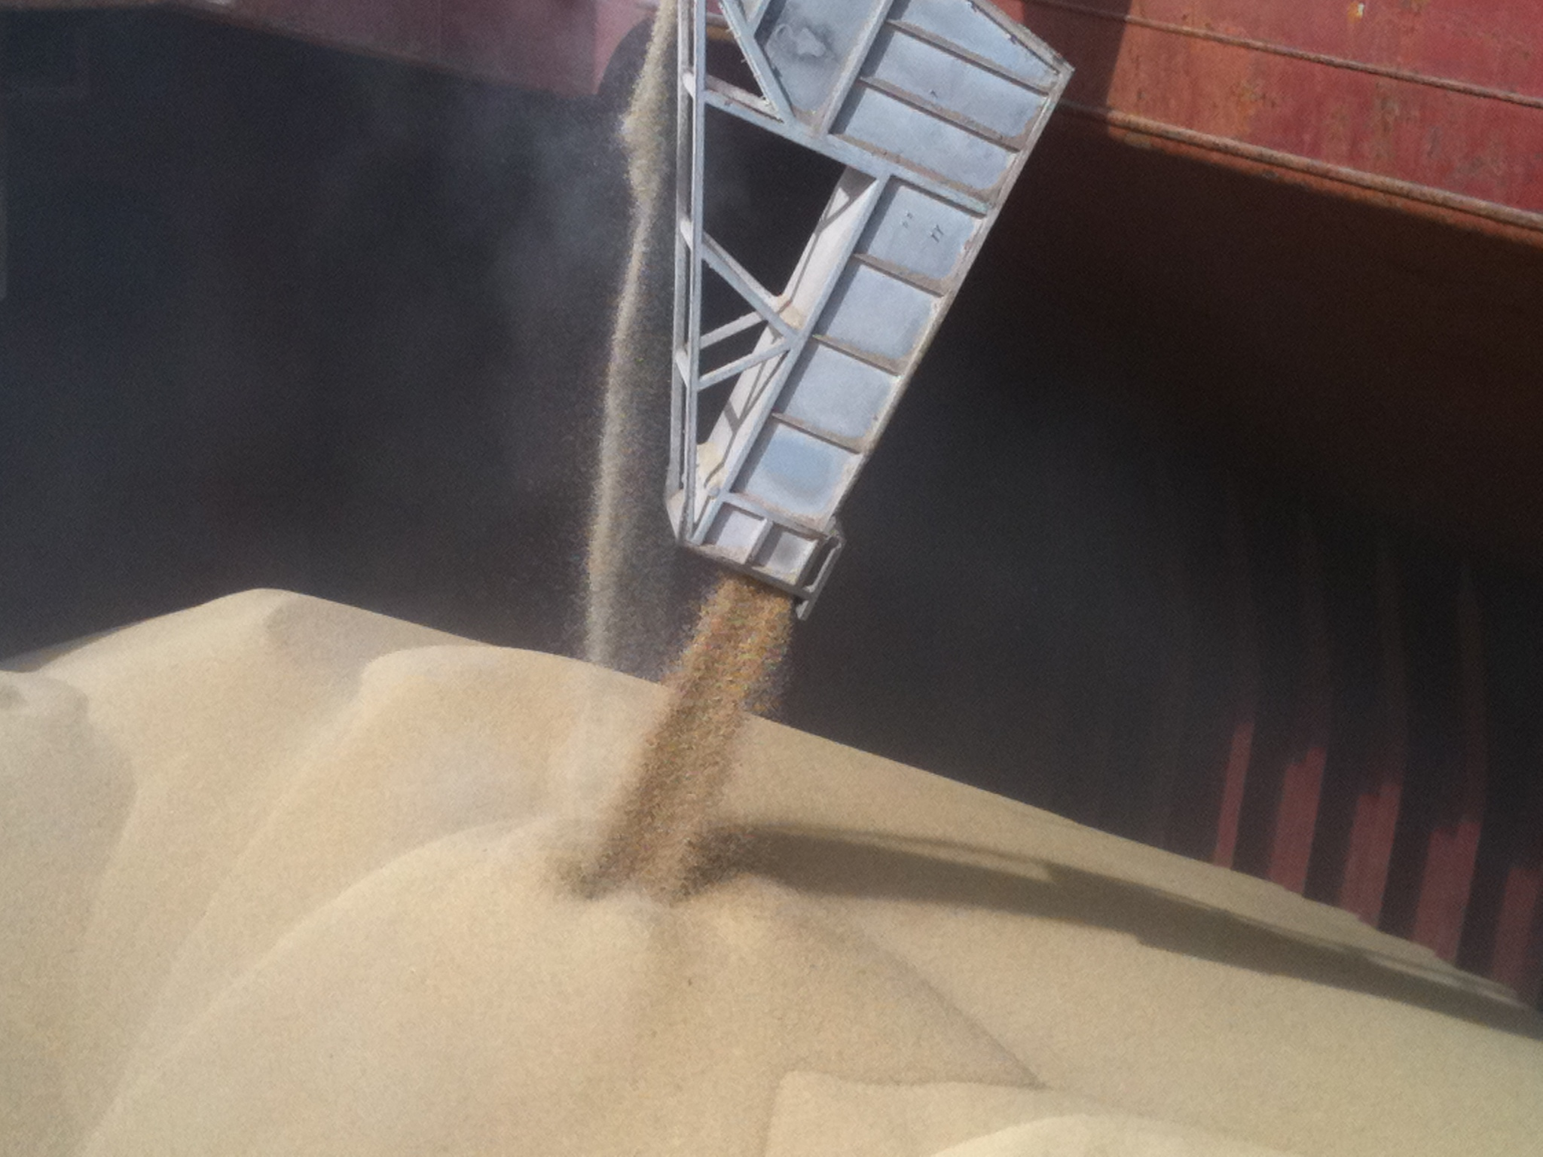
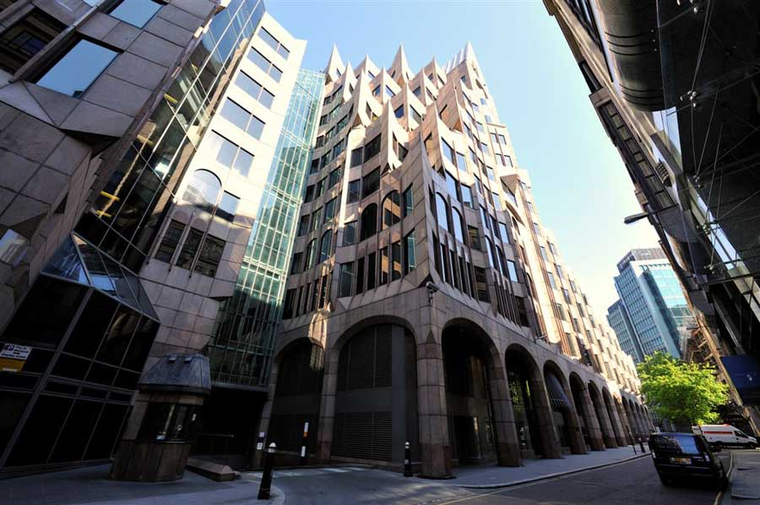
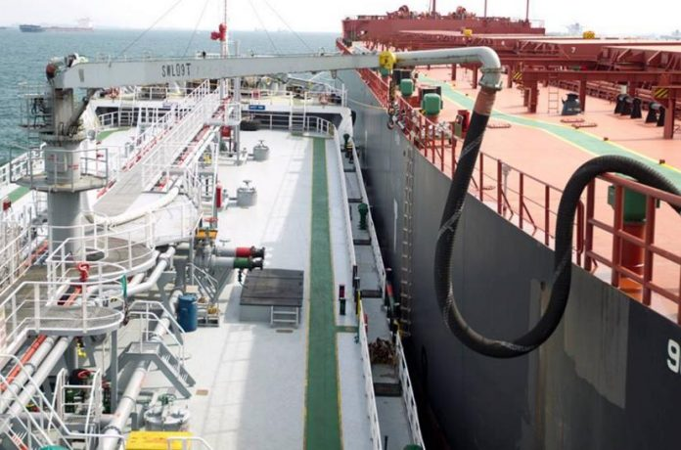
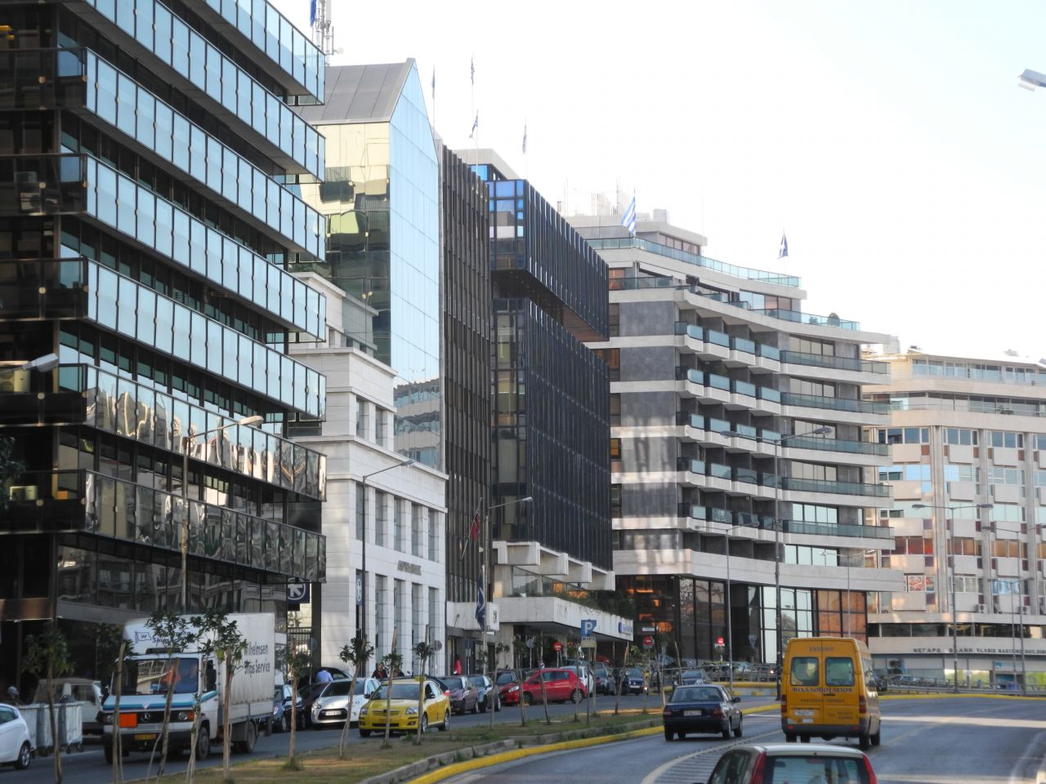
LOF - who is involved/who contributes?
The Vessel
- Hull and Machinery Underwriters
Cargo Interests
- Cargo Underwriters
Bunkers
- Time Charterers, or Owners

Slide 12
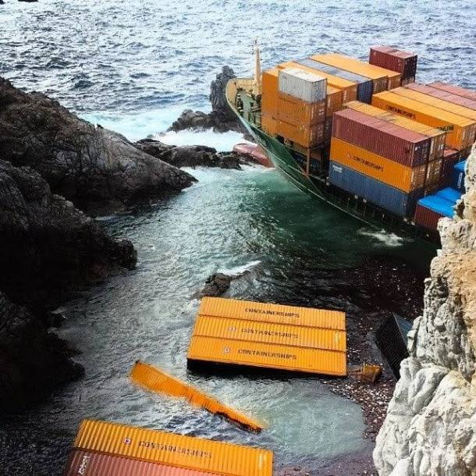
Where does the Club fit in?
SCOPIC
Cargo Interests
  – liabilities and claims

Slide 13
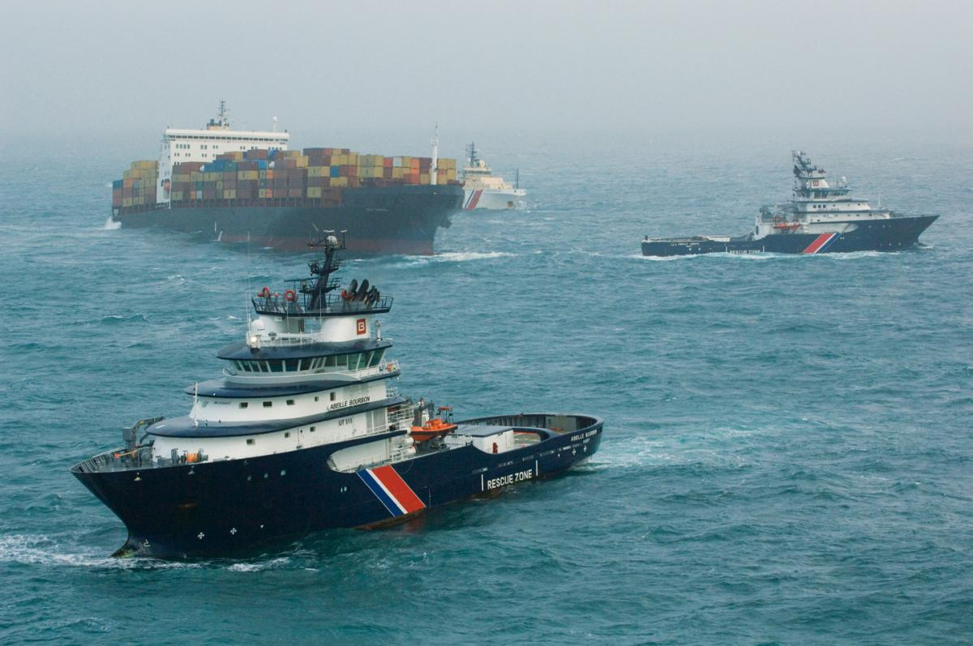
What is SCOPIC?
Special Compensation P & I Club Clause
Rule 2 Section 20
Liability of the Member to reimburse a salvor of the insured vessel for:
The “Special Compensation” to which a salvor may be entitled…contained in Article 14 of the International Convention on Salvage….or the SCOPIC clauses where they are incorporated into the Lloyds Standard Form of Salvage Agreement.

Slide 14
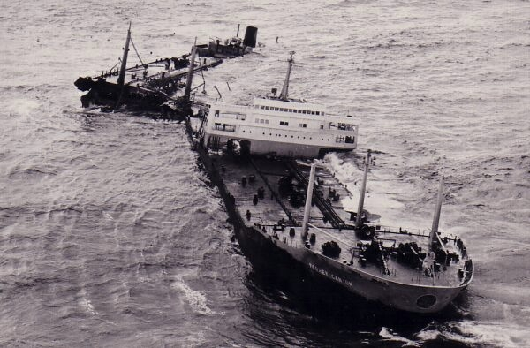
Why was SCOPIC introduced?
Torrey Canyon
1967
119,000 tonnes of Crude Oil

Slide 15
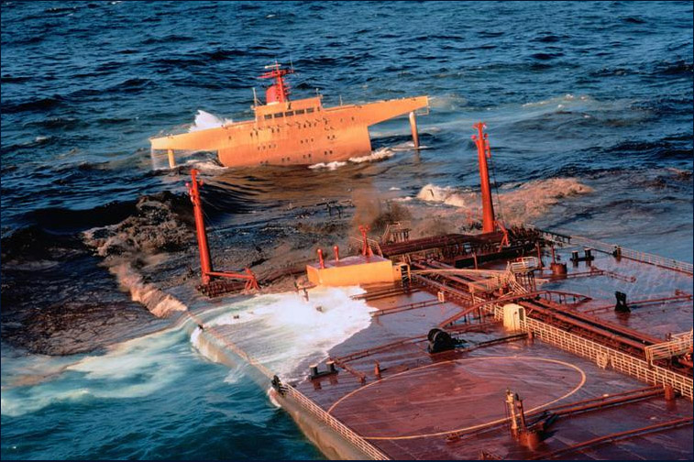
The next disaster
Amoco Cadiz
1978
220,000 tonnes light crude

Slide 16
SCOPIC/LOF – the Mixing Pot
Pre-Torrey Canyon/Amoco Cadiz
Post Torrey-Canyon/Amoco Cadiz:
1989 Salvage Convention
Introduction of Scopic
Different interests:
H&M Underwriters – liability to pay salvors
]
] Convention Article 13
]
Salvors – want to obtain salvage awards/payment for services
]
]
]
Convention Article 14
SCOPIC
Environmental issues/pollution – P&I

Slide 17
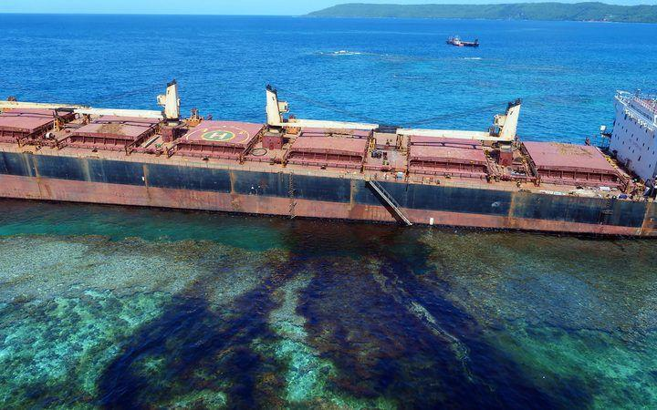
SCOPIC
Article 14 of the Salvage Convention
1989 Salvage Convention
Article 14 provides that salvors could receive Special Compensation - their expenses and a fair rate for tugs and equipment used in salvage operations - in certain circumstances where the salved fund was insufficient to allow them to recover adequate remuneration under Article 13
Pollution
“Costs of any measures reasonably taken for the purpose of avoiding or minimising pollution”
Salvors, H&M Underwriters and P&I Clubs address the problem
The SCOPIC clause was agreed and introduced. It endorsed the Article 14 concept and introduced a tariff to calculate the Contractor's Special Compensation together with an uplift fixed at 25%.
SCOPIC Clause introduced to the LOF from 1999

Slide 18
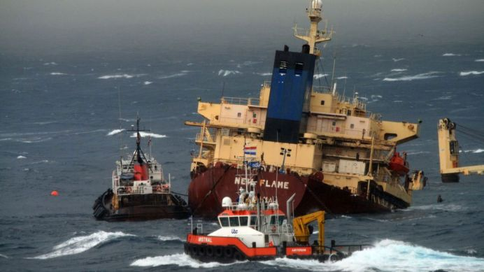
SCOPIC
- Invoking SCOPIC
LOF: Box 7: Is the Scopic Clause incorporated into this agreement?
State alternative Yes/No
Scopic Clause 2. The Contractor shall have the option to invoke by written notice to the Owners of the vessel the SCOPIC clause set out hereafter at any time of his choosing regardless of the circumstances and, in particular, regardless of whether or not there is “threat of damage to the environment”

Slide 19
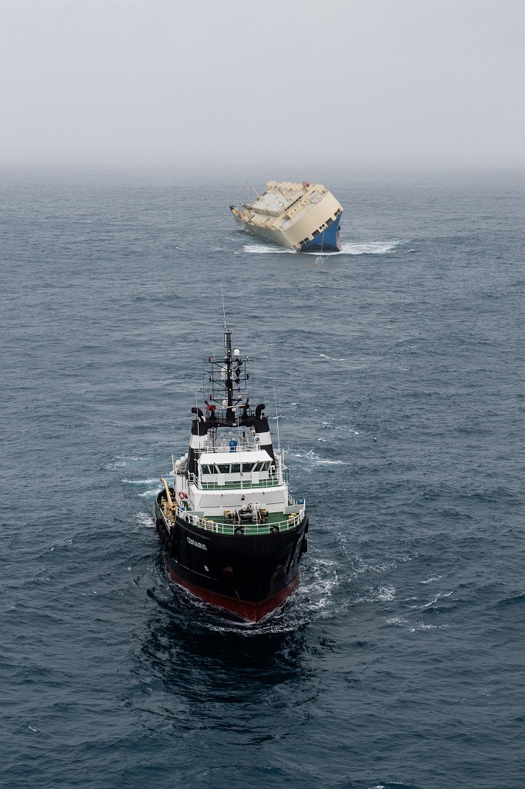
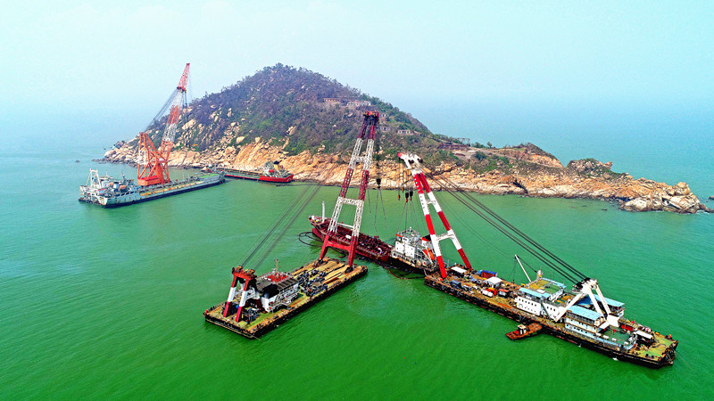
SCOPIC
Article 13 Award
LOF: Article 13 – Criteria for fixing an Award
Article 14 – Special Compensation
Article 13 Award
Salved Value of vessel and cargo
Skill of the salvors
Measure of success
Degree of danger
Time taken and expenses incurred
Promptness of action
Vessels and equipment used

Slide 20
SCOPIC
Why isn’t SCOPIC invoked every time?
Article 13 Awards are reduced by 25% if the sum awarded exceeds the SCOPIC remuneration
Example
Salvor invokes SCOPIC on LOF
Salvors’ expenses are $1m.
25% uplift gives a sum of $1.25 SCOPIC remuneration
  Article 13 Award is $800,000
  Salvor receives payment of $1.25m basis SCOPIC figures. (Club pays $1.25m - $800,000, or $450,000).
  Article 13 Award is $3m
  Salvors obtain $3m – 25% (of the difference between $3m and $1.25m) or $2.56m. (Club pays nothing under SCOPIC).

Slide 21
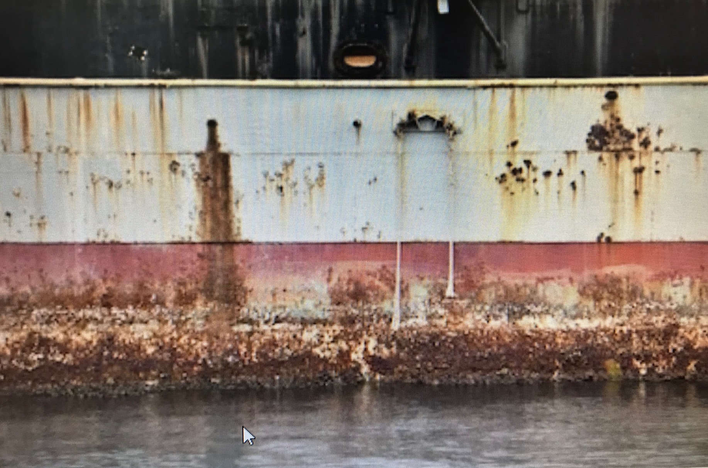
Where else does the Club fit in? –
Claims from Cargo interests
Unrecoverable General Average Contributions
The proportion of general average expenditure, special charges or salvage which the Member … would be entitled to claim from cargo … and which is not legally recoverable by reason only of a breach of the contract of carriage.
Cargo
Liability for loss...arising out of...unseaworthiness or unfitness of the insured vessel.

Slide 22
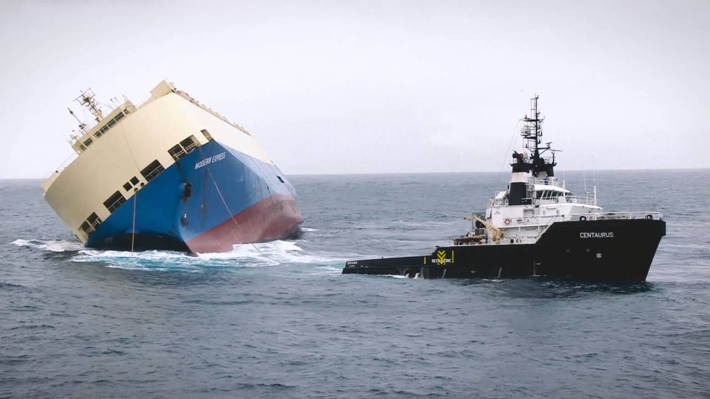
Claims from Cargo Interests
H&M
Salvage
Security
Salvors
Salvage Security
Cargo Interests
Security
Vessel

Slide 23
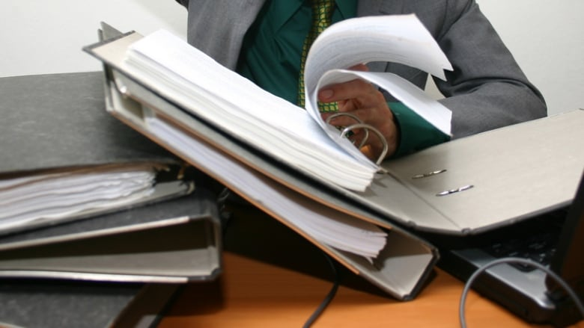

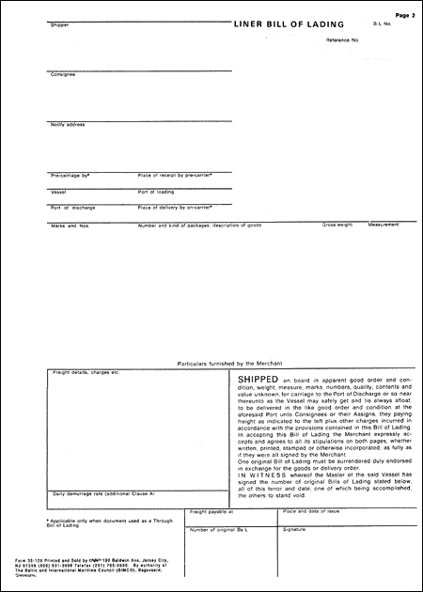
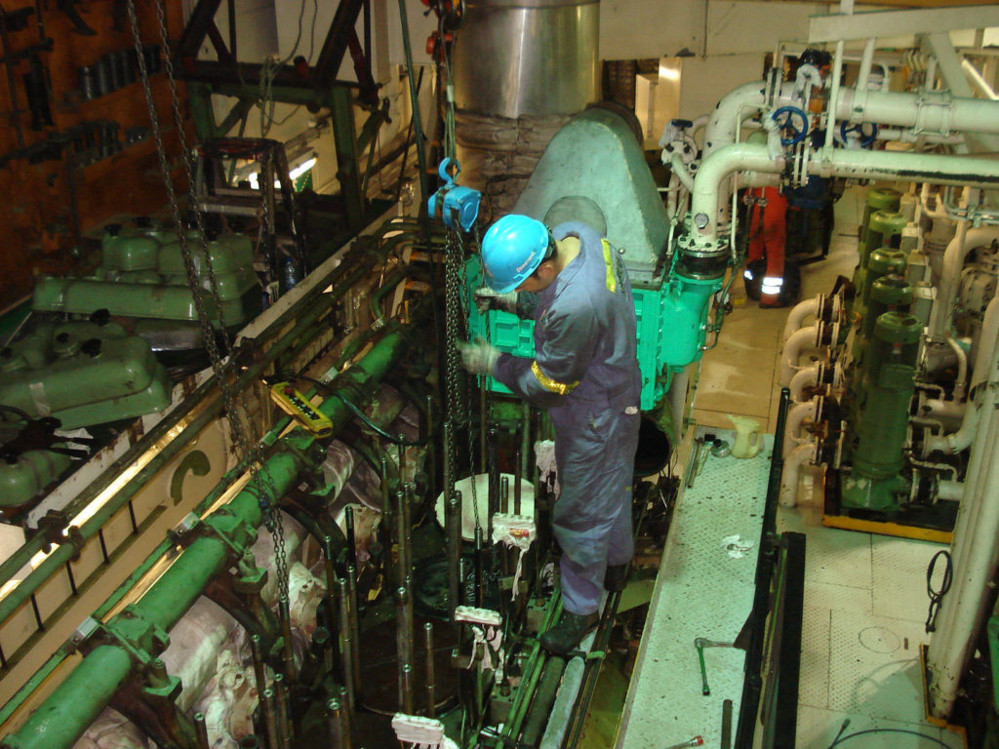
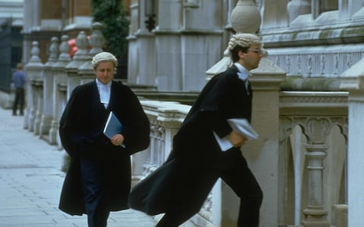
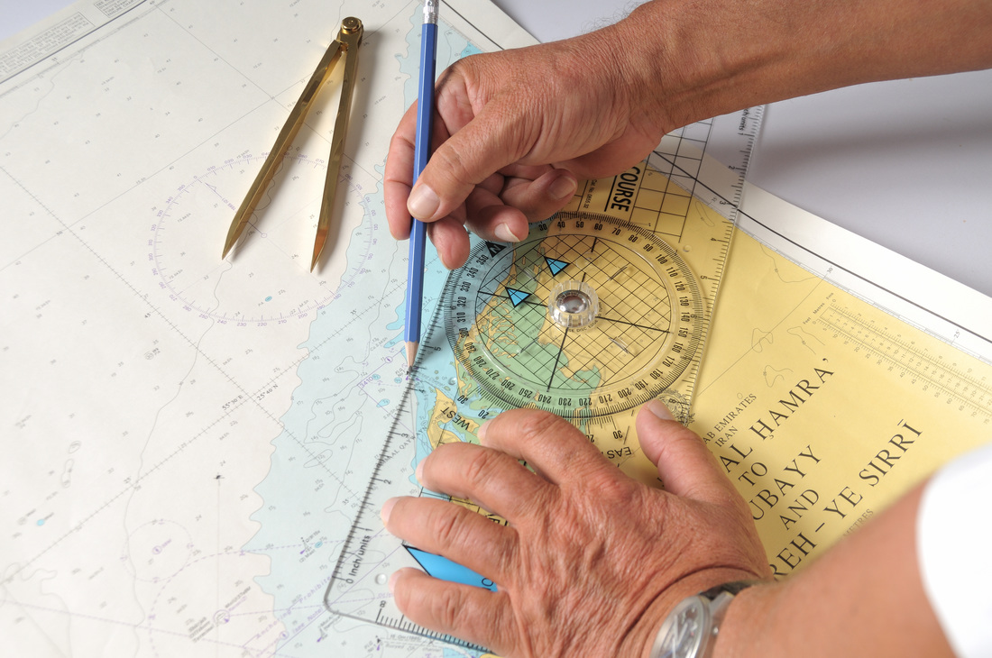
Pre-Existing unseaworthiness

Slide 24
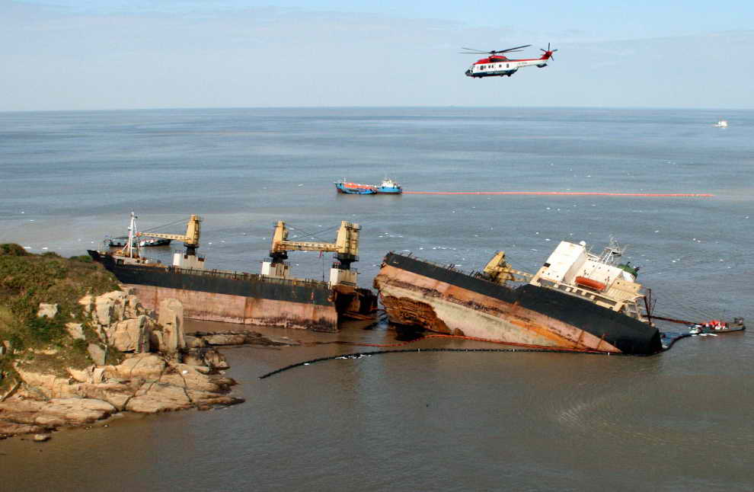
What if the vessel is beyond salvage?

Slide 25
What if the vessel is beyond salvage?
We are looking at wreck removal
Over to Enam……

Slide 26
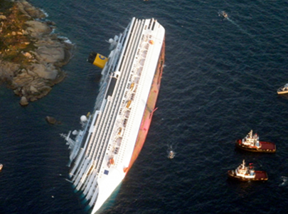
Part 2
Introduction
Liability for Wreck Removal Costs
Wreck Removal Convention
Wreck Removal Contracts
Scope of P&I cover

Slide 27
Wreck Removal
https://www.youtube.com/watch?v=t0ZSdVGLj-Y

Slide 28
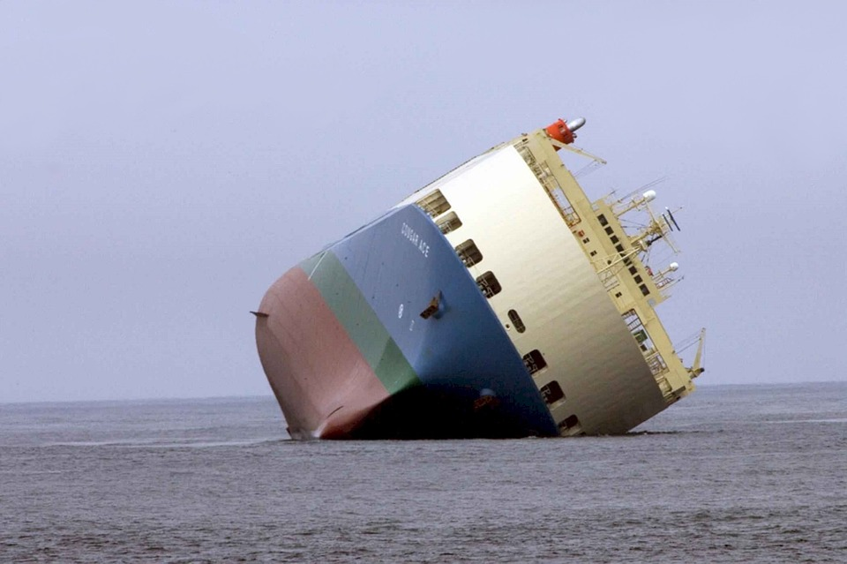
Liability for Wreck Removal Costs
General Aspects
  Legal Obligation on shipowners
  Wreck removal order
  Measures to be taken
  Recovery of costs

Slide 29
Law and Jurisdiction
Most local jurisdictions normally make the shipowner responsible for the removal of any property that is considered to be a threat to the territorial waters of that country
  Owners of the vessel involved must notify the coastal authorities promptly
  Owners of the wreck must mark the position of the wreck promptly
  Owners of the wreck will be required by the local authorities to remove or raise the wreck at its cost if it poses a danger to navigation and or the environment
  If the owners of the wreck do not do so, the local authorities will normally have the statutory power to do so themselves and to claim the costs from the owners of the wreck
  The shipowners may be entitled to limit their liability in relation to the wreck removal costs, but in several countries, no such limit applies, or a higher limit applies
  If the wreck has any residual value after it is raised, it can be sold and the proceeds used to defray the cost of the wreck removal

Slide 30
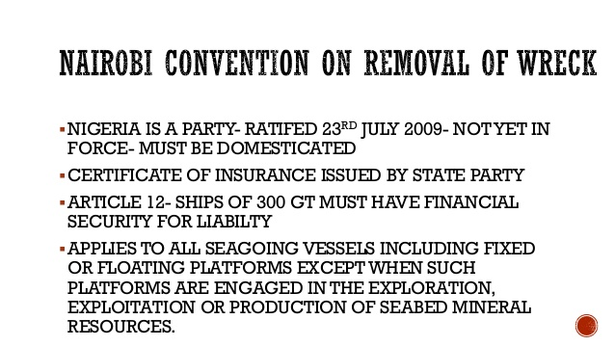
Nairobi Wreck Removal Convention 2007
The Convention entered into force in State parties on 14 April 2015
Convention provides a strict liability, compensation and compulsory insurance regime for States affected by a maritime casualty
Registered owner of a ship is liable for locating, marking and removing a wreck deemed to be a hazard in a State’s Convention area.

Slide 31
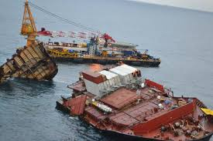
Limitation of liability for Wreck Removal Claims
Costs of wreck removal can be very high
Article 2.1 para (d) of the 1976 Limitation Convention
1996 Protocol to the 1976 Convention
1957 Limitation convention
Excluding right to limit

Slide 32
Scope of Convention
Provision in Article 3(2) for a State Party to include the territorial sea within the scope of the Convention.
  States which do not exercise this option, the Convention will apply in the exclusive economic zone but not the territorial sea.
  The IG submitted a paper in April 2014 to the IMO Legal committee reminding States that they may not avail themselves of the right of direct action conferred under the Convention to “wreck” incidents that occur in the territorial sea unless the scope of the Convention has been extended.

Slide 33
Insurance requirements
Registered owners of ships of 300 gross tonnage
  Registered in a State party or entering or leaving a port in the territory of a State party, will need insurance cover arrangements which meet the requirements of the Convention and a certificate from a State party confirming that such insurance is in place.
  The Wreck Removal convention closely follows the strict liability and insurance provisions which currently apply to oil tankers under the Civil Liability Convention (CLC) and ships of 1000 gross tonnages and over under the Bunker Convention.
  IG clubs issue the required Wreck Removal convention “Blue Cards”, to enable Members to obtain Certificates from State Parties

Slide 34
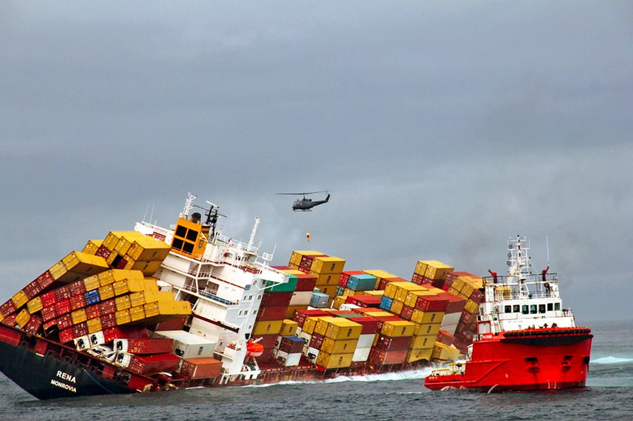
Wreck Removal Contracts
Tender process
Invitation to Tender
BIMCO contracts
  Wreckhire 2010 – daily hire
  Wreckstage 2010 – lump sum split into stages
  Wreckfixed 2010 – fixed price, no cure no pay

Slide 35

What does the Club cover?
Liabilities for or incidental to the raising, removal, destruction, lightning or marking of the wreck of an entered ship
  If the wreck and any stores and materials are saved, their residual value is credited to the club
Liabilities flowing from actual attempted wreck removal operations, including those involving cargo and other property on board;

Slide 36
Club cover
Liabilities resulting from or involuntary shifting of a wreck, including cargo, or property on board
Liabilities for, or incidental to, the raising, removal, destruction or disposal of cargo or any other property which is or which had been carried on the ship. Again, the residual value of cargo or any other property saved is credited to the club.
The Wreck must have arisen out of a out of a casualty, there must be a legal obligation on the member to remove the wreck

Slide 37
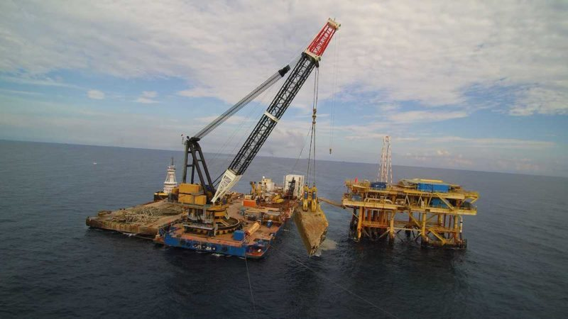
Examples of Wreck Removals
India
Brazil
Indonesia

Slide 38
Thank you.

