Slide 1
Sanctions
West of England Member Training Week, September 2022

Slide 2
History of sanctions
Sanctions used in the past but limited effect
Clinton government - use of “smart sanctions”
Targeting individuals, companies and other specific entities rather than entire population
Recent sanctions measures have often seen concentration on the maritime community…

Slide 3
Why are we a target?
Governments realised maritime/insurance community is conservative & risk adverse
Key to curtailing trade with targeted state
Encourage grey areas – creates uncertainty
Blunt (but effective?) means of bringing about change
Current tool of choice - unlikely to see an end to them soon

Slide 4
Applicability of sanctions (US)

Slide 5
Sectoral sanctions
Some (e.g. Gazprom) on special “Sectoral Sanctions” list
Target specific sectors & industries – energy, banking
Prohibit certain types of activity as set out in Directives (US)
Currently limited to provision of certain types of debt financing > 30 days
Caution required on things like demurrage
Otherwise not SDNs & no bar on trade
But prohibited activity can be changed at short notice

Slide 6
Application of sanctions
EU sanctions apply:
within the territory of the EU
on board any aircraft or any vessel under the jurisdiction of a Member State
to any person inside or outside the territory of the EU who is a national of a Member State
to any legal person, entity, or body, inside or outside the territory of the EU, which is incorporated or constituted under the law of a Member State
to any legal person, entity, or body in respect of any business done in whole or in part within the EU.
US primary sanctions apply directly to US persons - wherever they are - but:
Non-US persons can also be punished for breaching US secondary sanctions - extraterritorial measures

Slide 7
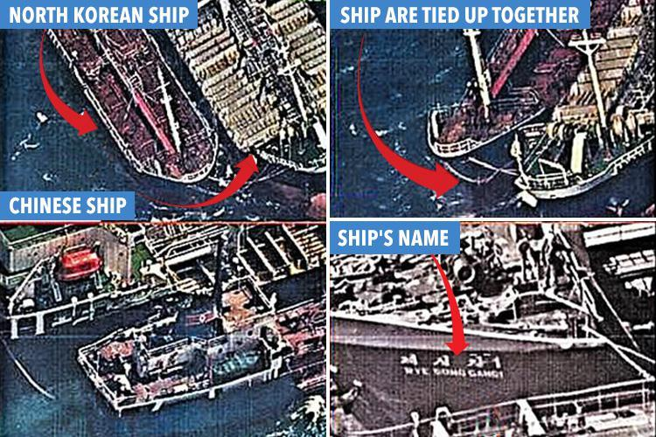

Slide 8
They are watching!
Activity involving sanctioned states is being monitored
United Nations, intelligence agencies, other governmental depts, NGOs
AIS, satellite, warships, submarines, drones, human intelligence, electronic measures?
Club has been notified of suspect activity
See insurers as pressure point

Slide 9
AIS is the answer!
No it isn’t
Seen by US regulators as panacea - “going dark” strong indicator of nefarious activity
But it happens for many reasons – e.g. malfunction, range, traffic density
Tracking platforms widely available
AIS tracking therefore now a central component of compliance
Insurers forced to adopt it - all Clubs now track vessels in high risk areas
Others are doing the same – you are being watched!

Slide 10
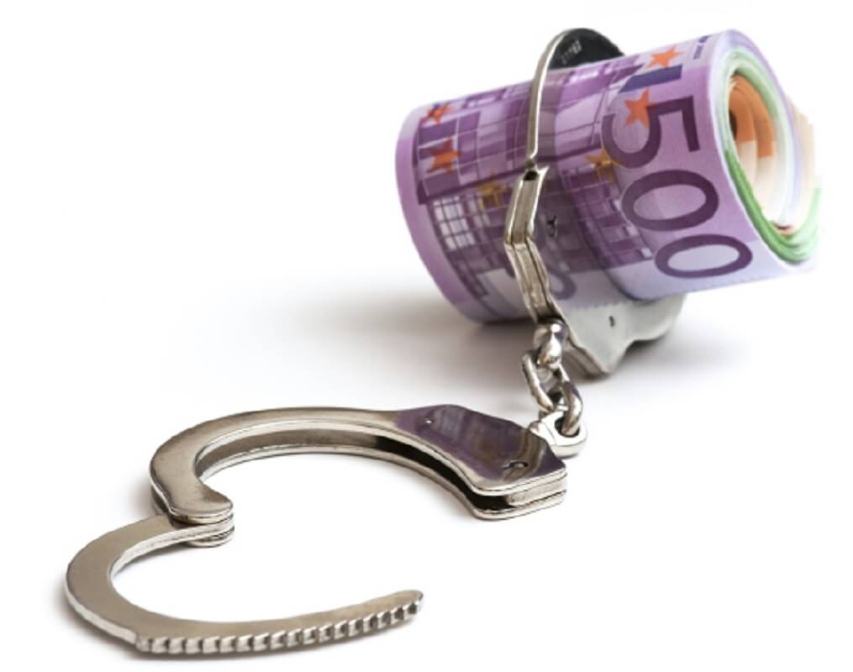

Slide 11
Enforcement of sanctions – penalties
Denial of travel to US
Asset freeze in US
Corporate and individual fines
Denial of access to US banking system – no longer able to trade in US$
Designation – unable to trade ships, raise finance
Criminal penalties in EU
Loss of insurance cover – voyage or complete

Slide 12
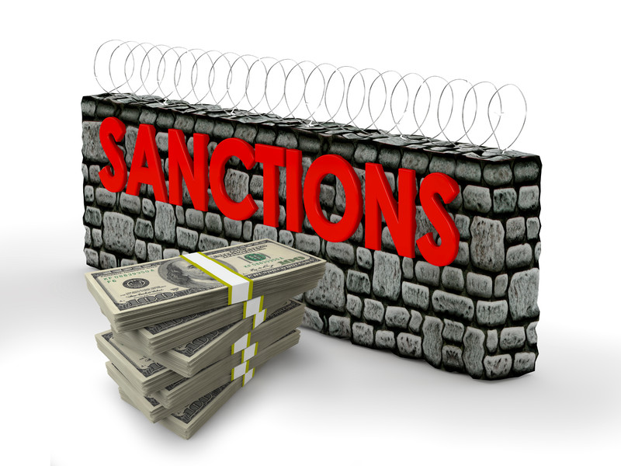

Slide 13
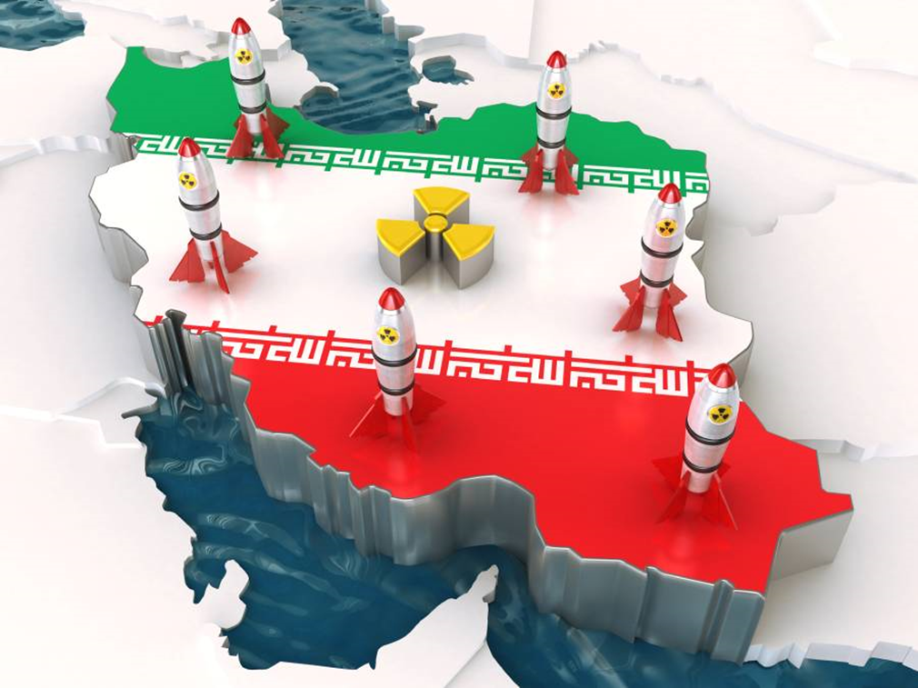
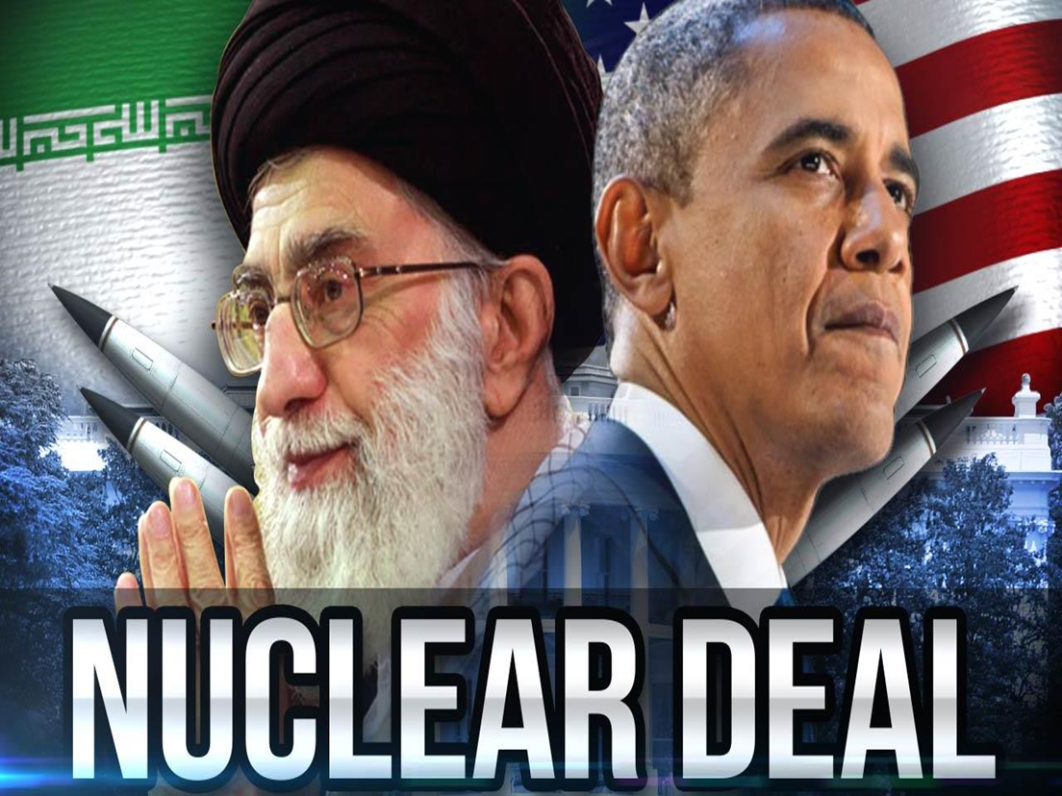
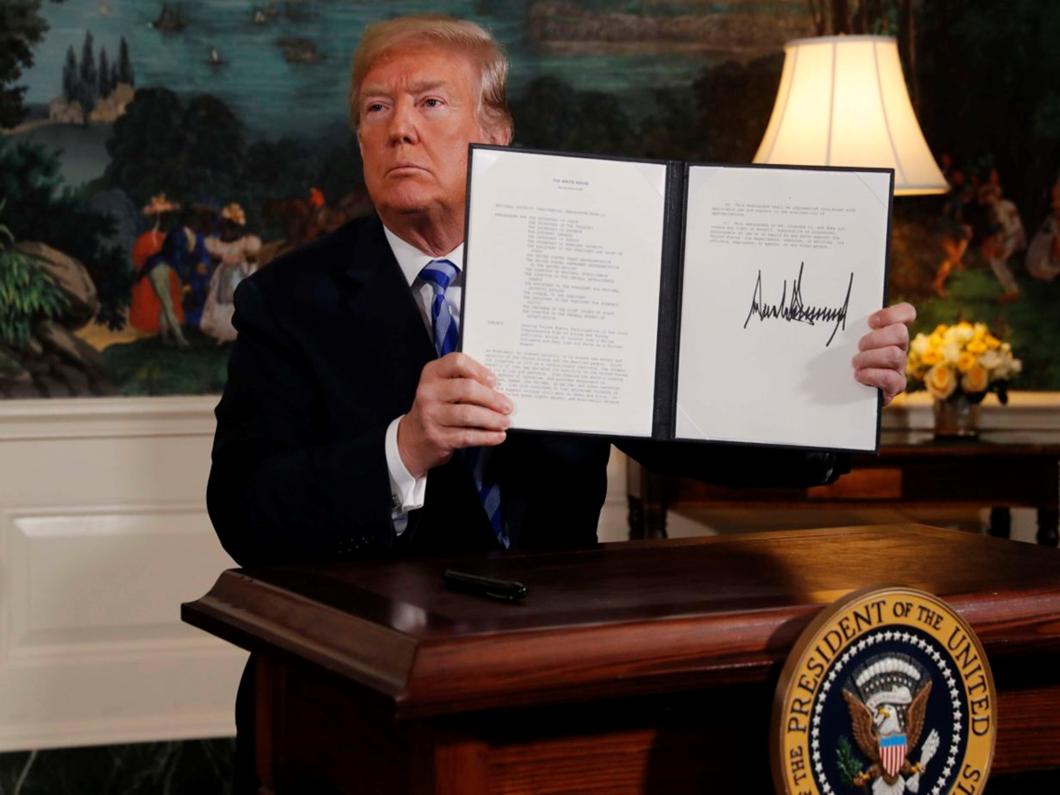

Slide 14
Iran – what is prohibited?
Crude, CPPs, gases, petrochemicals
Goods which support refining capacity (including sulphur)
Oil and gas exploration and production equipment
Materials to be used in nuclear & energy industries
Cars or car parts
Supply of shipping services & insurance

Slide 15
Iran – what is prohibited?
“Significant” transactions involving:
raw or semi-finished metals (e.g. aluminium & steel) + coal to/from Iran (includes ores)
goods or services used in connection with iron, steel, aluminium, or copper sectors
What does “significant” mean? No clear answer, case-by-case basis, based on OFAC assessment of several factors

Slide 16
Iran – what is allowed?
Food
Agricultural goods
Medicines
Humanitarian goods
(Always assuming no SDN involvement)

Slide 17
Iran – beware!
Do not:
Trade with SDNs – check lists
Carry prohibited goods
Make payments in US$ (or mask them)
Use Tidewater Middle East terminals
Club unlikely to be able to support you:
Payments to Iran impossible – surveyors, correspondents, claims, reimbursements
No bail
Reinsurance shortfall risks
Limitation an illusion – “Alpine Eternity”

Slide 19
Prohibited transactions
Oil and petroleum products from Syria
Jet fuel & additives into Syria
Making economic resources available to SDNs
Assad regime and those involved in repression
Government departments may be ultimate receiver – cannot pay
Fines for cargo shortages – cannot pay

Slide 20
Syria – beware!
Key installations often government owned
e.g. Banias - “Syrian Government-controlled”
Terminal & pipelines operated by Syrian Company for Oil Transport
Sanctioned by EU and US – no port dues
Payments to Syria very difficult
Bail very unlikely
Reinsurance shortfalls?

Slide 21
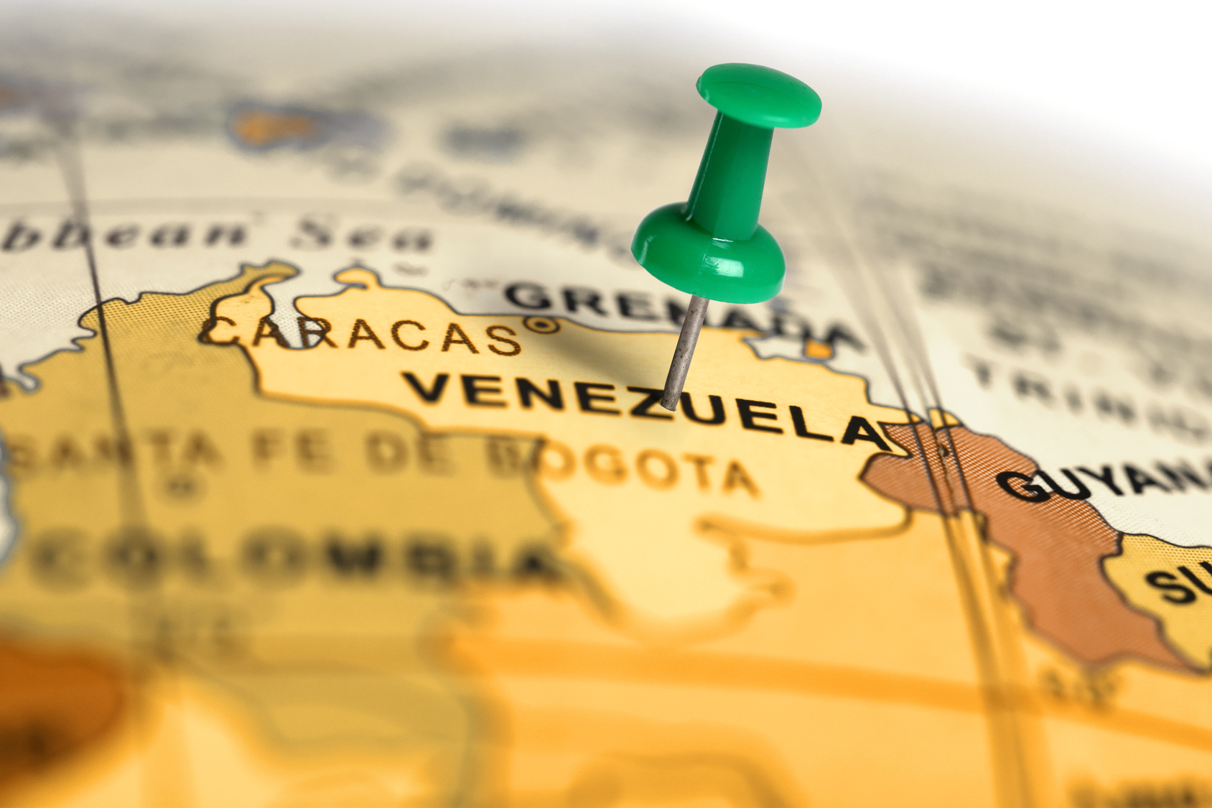

Slide 22
Venezuela – lack of clarity
No clear lines around what is and isn’t permissible
Reliance instead on couple of key phrases:
“Operating in oil sector of the Venezuelan economy”
“Materially assisted, sponsored, or provided financial, material, or technological support for, or goods or services to or in support of [a sanctioned entity]”
Interpretation has changed over time, to target different trades and build pressure
Designate first, ask questions later?
Learned from experience that full fleet designation not necessary – only one and extract promise

Slide 23
Oil Sector/PDVSA
PDVSA made SDN Jan 19, several general licences issued, non-US persons can still trade
But US interpreting regulations fluidly to suit immediate political goals
Ships carrying petroleum Cuba - Venezuela “operating in oil sector of Venezuelan economy”; designated without warning – flag, class, insurance cancelled immediately
Further warnings from US administration: trade with PdVSA may be treated same way
Carriage of petcoke may be permissible for non-US persons but still bears risk

Slide 24
Venezuela – beware!
Avoid any dealings with a designated entity – i.e. oil sector or Govt entity
Trade with private parties should be lower risk but check true ownership
Avoid use of US$ and “Petro” cryptocurrency
Systemic risk of trading to Venezuela if SDN inadvertently becomes involved, e.g. contact with PdVSA facility, oil spill cleaned by Government assets:
Club unable to pay any fees/claims/reimbursements or provide bail
OFAC licence may be required and our banks might refuse anyway
Vessel may be heavily delayed at the least
If major claim, US reinsurers may not pay and Member may have to bear shortfall
Club cover remains in place for calls to Venezuela - but will cease immediately if designated
May designate without warning

Slide 25
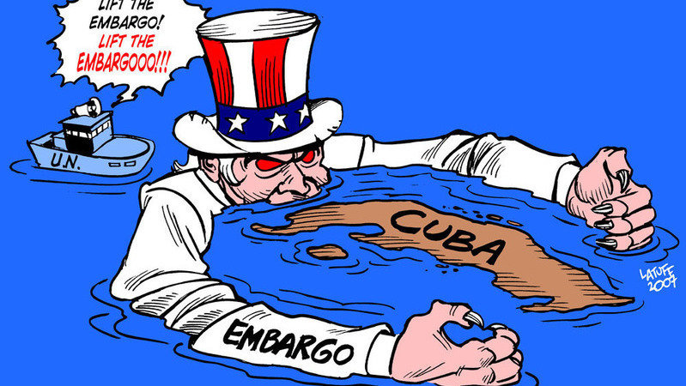

Slide 26
Cuba
US sanctions do not directly target non-US persons
Many entities in Cuba SDN listed in US (often state owned)
Cuban state is not in itself sanctioned but its state companies are
The 50% SDN ownership “waterfall effect” may be material
US SDN list has no extraterritorial effect
But a non-US person can face sanctions if they knowingly cause, aid or abet a US person violating primary sanctions

Slide 27
The 180 Day Rule
Non-US vessel that calls Cuba cannot call in USA waters for 180 days unless authorised by OFAC, even for repairs or bunkers
But vessel exempt if carries cargo to Cuba from third country classified as EAR99
EAR99 depends on whether for anti-terrorism reasons the cargo would be controlled under US export rules (the Commerce Control List)
Agricultural goods and low technology do not need a US export license so are clear under EAR99
Department of Commerce BIS provides further guidance

Slide 28
Cuba – beware!
Banks may not permit even Euro or non-USD transactions
The Club may not be able to assist/secure/pay claims that involve US sanctions
Especially if SDN involved (perhaps inadvertently – FFO, pollution clean-up, etc.)
Even if clear, there may be recovery shortfalls with reinsurers
Make sure cargo is EAR99 or no US calls for 180 days

Slide 29
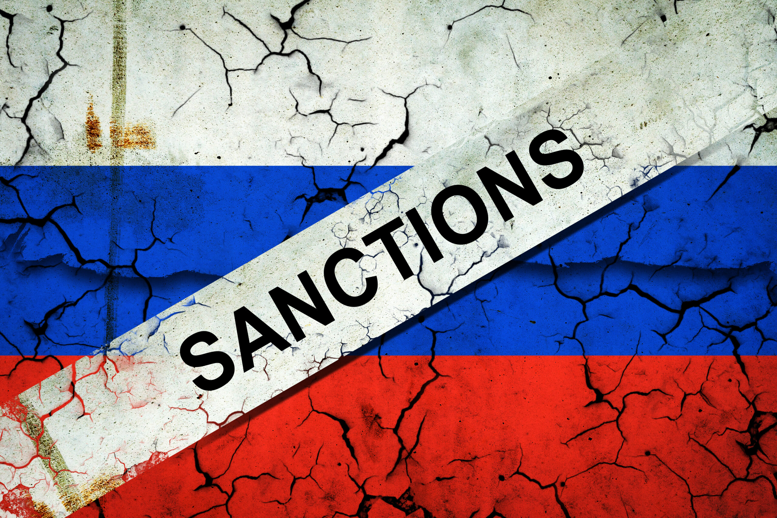

Slide 30
Ukraine war – a whole new world of sanctions
Unprecedented sanctions framework intended to bring about Russia’s withdrawal
Three primary regimes US, EU & UK but other individual measures (e.g. Canada, Japan, Australia, New Zealand)
EU have been most prolific – now on 6th sanctions package (Regulation 833/2014)
UK particularly active in designating oligarchs + import & export bans on cargoes, also important due to insurance industry
US blocking sanctions on banks, restrictions on some entities & trade restrictions
Some coordination between the three but not fully consistent – need to consider the impact of all three on your trades

Slide 31
Russian Sanctions – current cargo restrictions (1)
Iron and Steel – import into EU & UK + transport to any other country from Russia, explicit insurance prohibition
Coal/solid fossil fuel + goods which earn Russia significant revenue (e.g. cement, rubber, wood, some fertilisers) - import into the EU, now prohibition on carriage & insurance of that carriage worldwide by any EU entity following re-interpretation & FAQs 10 August 2022:
“It shall be prohibited to purchase, import, or transfer, directly or indirectly, goods which generate significant revenues for Russia thereby enabling its actions destabilising the situation in Ukraine, as listed in Annex XXI into the Union if they originate in Russia or are exported from Russia.”

Slide 32
Russian Sanctions – current cargo restrictions (2)
Oil – import into EU & US (UK currently has no prohibition although phase out planned)
EU – carriage of Russian crude into EU only allowed until 5 December 2022, products until 5 February (gas currently not included); EU insurers can provide cover until 5 December as long as vessel was insured on 4 June 2022
No carriage by EU entity of Russian crude & products after those dates
EU insurers prohibited from insuring carriage of these cargoes worldwide after 5 December 2022
G7 price cap mechanism?

Slide 33
Russian Sanctions – current cargo restrictions (3)
Jet fuel and additives – export from UK & EU
Luxury Goods – export & import US, export from EU & UK
Restricted/military/dual use/oil refining/gas liquefaction/energy-related goods – export from US, UK & EU

Slide 34
Russian Sanctions – designated entities
US – some designated entries applicable to maritime trade, including number of vessels/shipping companies: FESCO, Northern Shipping, Sovcomflot
But primarily banks - US has 190 Russian banks + branches, EU + UK sanctions & asset freezes, many removed from SWIFT system
Entitles such as Rosneft, Transneft and Gazprom subject to US sectorial sanctions
UK – designated Sovcomflot, wide number of individuals (c.1300), directors/ex-directors
EU designated wide range of entities, concentration on entities wholly or majority owned by Russian state (Annex XIX) with particular impacts on shipping

Slide 35
Russian Sanctions – designated entities (EU)
Prohibited under Article 5aa of EU Regulation to “directly or indirectly engage” with designated entities listed in Annex XIX of the Regulation. Current list:
Rosneft
Transneft
Gazprom Neft
Sovcomflot
Russian Maritime Register of Shipping
Novorossiysk Commercial Sea Port
But certain exceptions apply, including:
Transactions strictly necessary for import or transport into EU of natural gas, titanium, aluminium, copper, nickel, palladium & iron ore, coal & other solid fossil fuels; crude & products regardless of destination

Slide 36
Impact of Article 5aa on ports
Transneft one of entities listed in Annex XIX
Majority shareholder of Novorossiysk Commercial Sea Port Group, which includes Port of Novorossiysk & Primorsk Trade Port – major Russian export terminals
Now clarified that:
Entities, including vessels, with EU nexus prohibited from using these ports for any purpose apart from exceptions above; includes transactions strictly necessary for carriage of Russian crude & products but EU insurer cannot provide cover for trade outside EU
Insurance for port calls not prohibited but EU insurer cannot make payment to designated parties or reimburse liabilities - Members essentially uninsured for FFO, etc

Slide 37
Systemic risks of trading to Russia
Banks often adopt conservative approach + many Russian banks designated
Club may be unable to pay fees & claims into Russia - or at least delayed
Banks may also block reimbursement claims even if Members pay first
Provision of bail problematic if not impossible
Inadvertent involvement of SDNs (e.g. FFO claim) would mean lengthy delays while Club seeks licence – may not be granted
Any reinsurance shortfall caused by sanctions falls back on Members
Sanctions situation extremely fluid & subject to change at short notice
Remember any trade to Russia + transit now requires report to the Club

Slide 38
Reporting trades to Russia
UK issued General Trade Licence (GTL) to clarify prohibitions around provision of insurance & reinsurance by UK entities for vessels calling at Russian ports or transiting Russian waters
Requirement of GTL for insurer to hold details of voyage, must then store records for current year + four more years & allow UK Government to inspect on demand
All Members trading to Russia must complete template & submit to Club’s dedicated mailbox within one month of voyage completion (or potentially lose cover for any claims)
Club in scope because of London office + UK persons (but impact of Lux law)

Slide 39
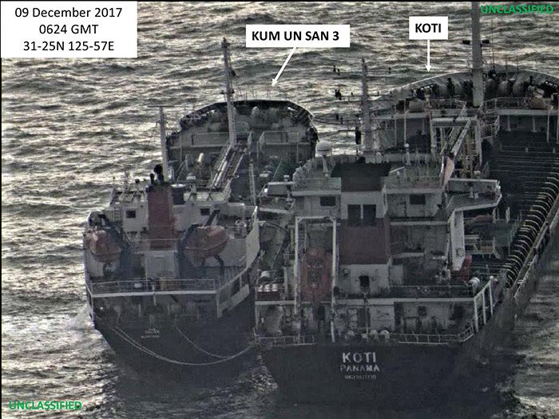

Slide 40
Club cover – Rule 19A
(1) No cover for any trade which exposes Club to risk of being or becoming subject to any sanction, prohibition or adverse action
(2) No liability to Member where any liabilities, costs & expenses not recovered from Pool, GXL contract or any other reinsurer because of sanctions
(3) Where Member’s conduct might expose Club to risk of being or becoming subject to any sanction, prohibition or adverse action, Club entitled to terminate cover Member immediately & without notice

Slide 41
Potential reinsurance shortfall
Non-Pollution
Pollution
$100m - $3.08bn
Group Excess Loss (GXL) Reinsurance
$100m - $1bn
$10m - $100m
IG Pool
$10m - $100m
$10m
Club retention
$10m

Slide 42
Potential reinsurance shortfall
Club retention – not a problem
IG Pool – American Club
Group Excess Loss contract (GXL) – c.35% US capacity, EU reinsurers also key players in GXL contract
Clubs may be unable to reimburse reinsurance shortfall due to sanctions (unless certificated liabilities – re-pooled because of blue card exposure)
So may fall on Member’s shoulders

Slide 43
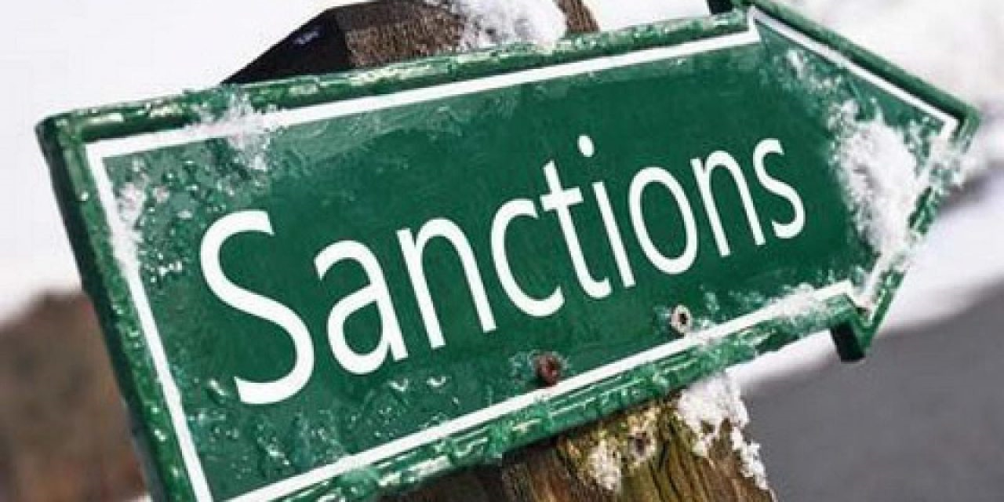

Slide 44
How can your Club help you?
Sanctions are wide-ranging – not just EU/US issue
Grave penalties in case of violation, including loss of Club cover
Members’ responsibility to ensure not in breach or risk losing insurance cover
But Club is happy to offers information & advice:
Webpages on major sanctions risks (https://www.westpandi.com/news-and-insights/Sanctions)
Neptune provides sanctions information at port level
Individual risk-based opinion of sanctions risk
Qwest Forensics – dedicated investigations and due diligence service, able to undertake detailed AIS tracking, investigation into ship movements when dark, full KYC (https://www.westpandi.com/Products/Qwest)

Slide 45
Thank you
E-mail: tony.paulson@westpandi.com ian.clarke@westpandi.com
Webpage: westpandi.com/news-and-events/sanctions/

