Slide 1
Protection & Indemnity:
An introduction to Club Cover
Adrian Hodgson - Senior Claims Manager
Monday 12th September 2022

Slide 2
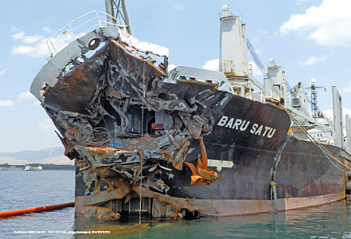
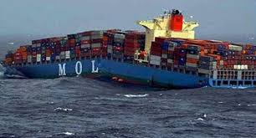
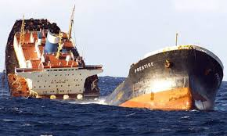
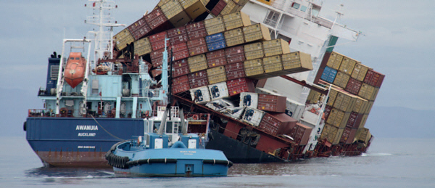
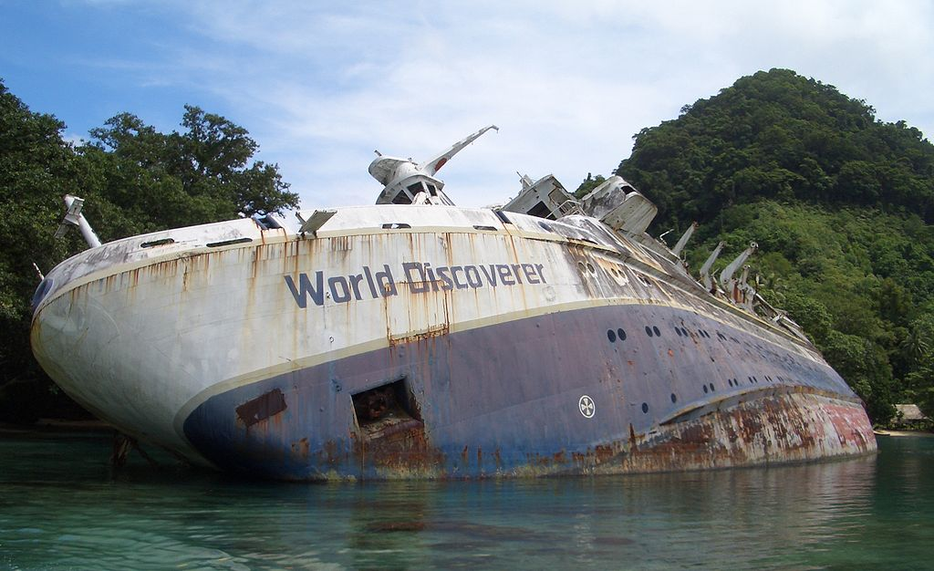
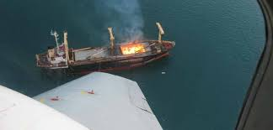
“If anything can go wrong, it will!”
Insurances
Hull & Machinery underwriters
Damage to Hull
Damage to Machinery
Loss of hire underwriters
_________________
P&I insurers
Liabilities to 3rd Parties

Slide 3
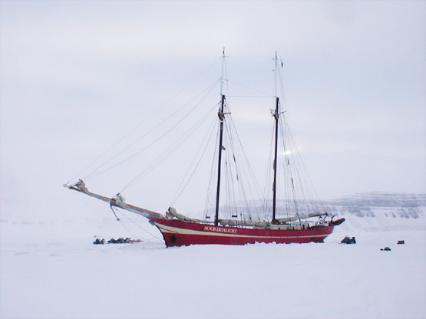




The P&I Year
The traditional day for the restart of
fixing vessels on the Baltic Exchange
12 noon, GMT

Slide 4




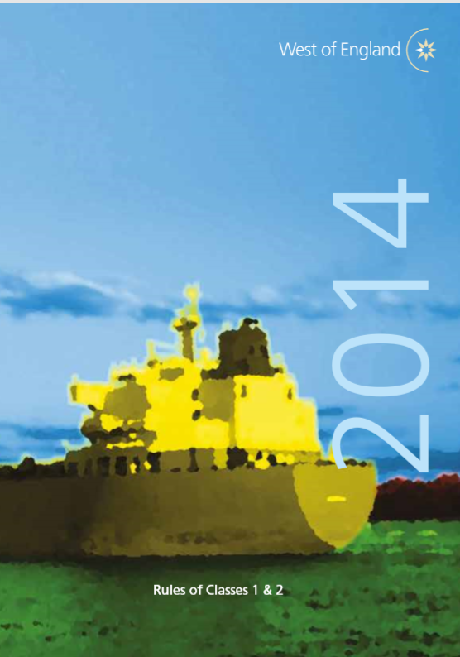

Club Cover : “The Rules”
Class 1: Protection & Indemnity (P&I)
Class 2: Defence
4

Slide 5
Basis of Cover : Rule 2
Liabilities costs and expenses arising:
    out of events occurring during period of insurance
    in respect of members interest in the insured vessel
    in connection with the operation of the insured vessel
Provided that:
    risk is not excluded
    cover is only in respect of the capacity in which the member has entered the insured vessel
5

Slide 6

Main heads of P&I Cover : Rule 2
Shipowner’ liabilities for:
Crew and Others
Passengers
Stowaways
Collision
Loss or damage to property
Pollution
Salvage and Wreck removal
Cargo
GA Contributions
Fines

Slide 7

Indemnity only, not liability cover : Rule 10
No liability on Club until claim paid by member

Slide 8
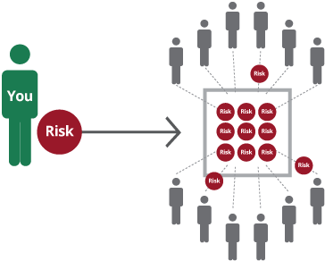
Deductibles : Rule 6
Deductibles apply
to claims
and to costs
as defined in the Rules
or as agreed with the Member
If more than one claim arises out of the same incident, only the highest deductible applies

Slide 9

People claims :
Rule 2, Sections 1, 2, 3, 4, 5, & 8
Who ?
Seamen
Passengers
Persons other than seamen and passengers
ie: “visitors”
eg: stevedores, port officials, pilot etc.
What for ?
Injury, illness and death
Compensation for loss of employment following shipwreck
Repatriation and substitutes’ expenses
Deviation expenses

Slide 10

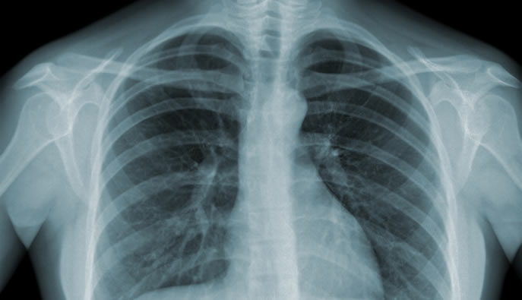

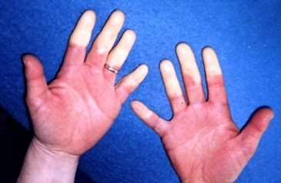
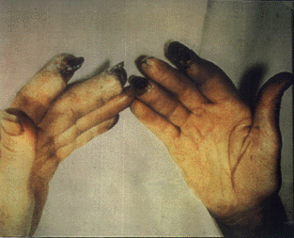
Industrial disease
Seafarers and others, inc.family
VERY long-tail claims
eg: Asbestos
Pleural plaques
Asbestosis
Cancer
Mesothelioma
Vibration white finger
Hearing loss

Slide 11
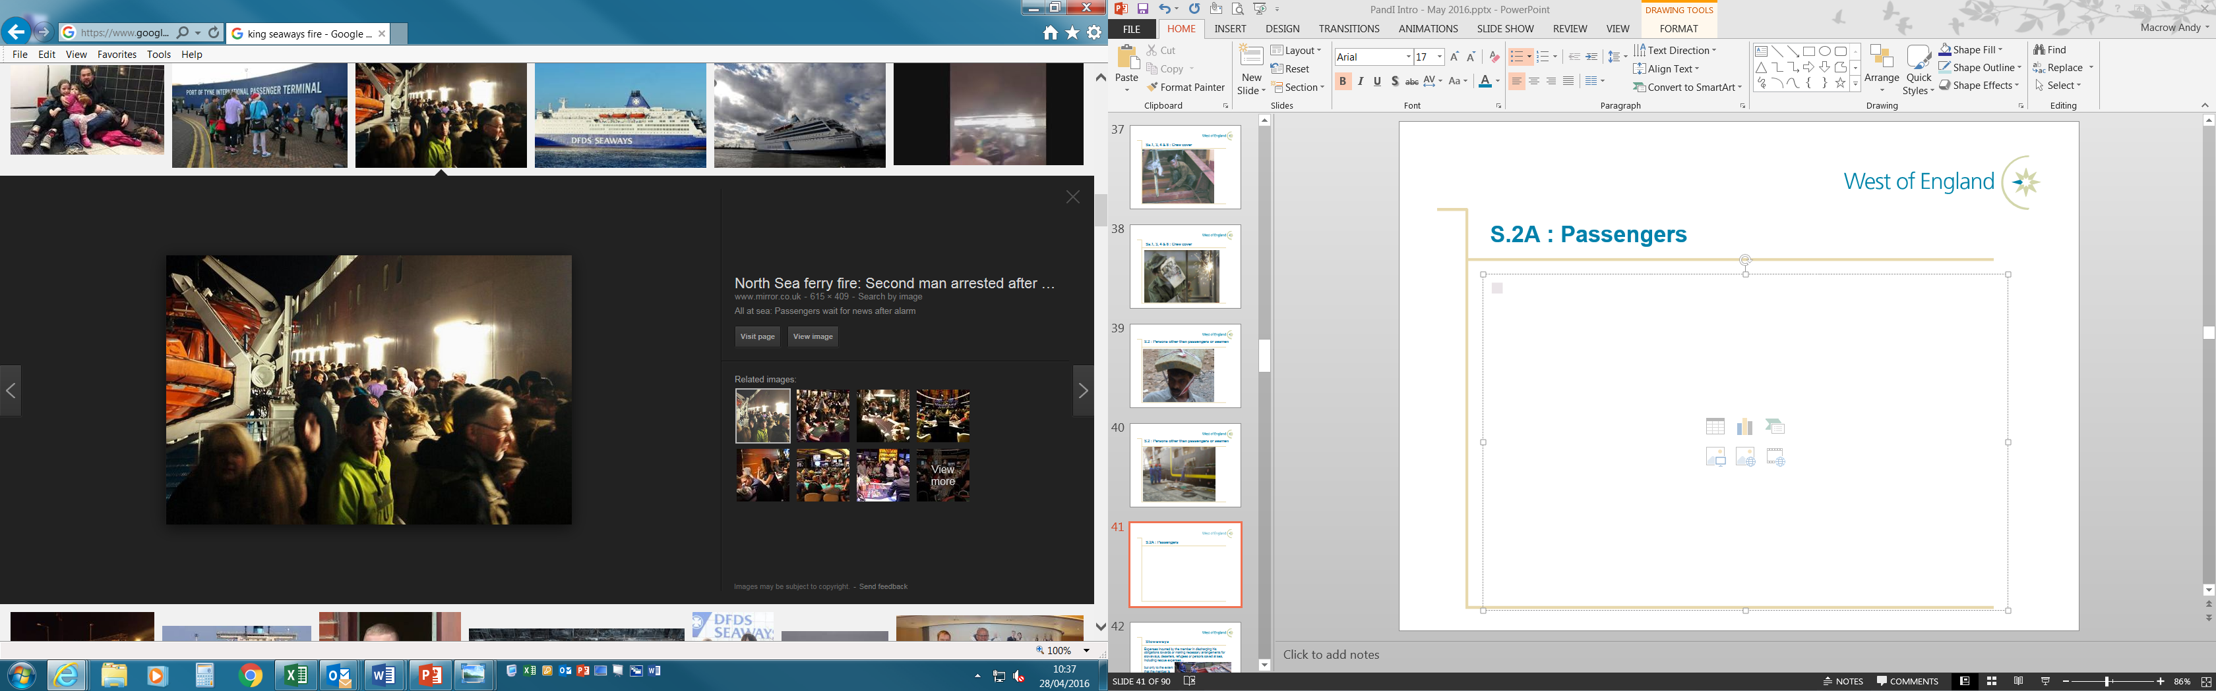
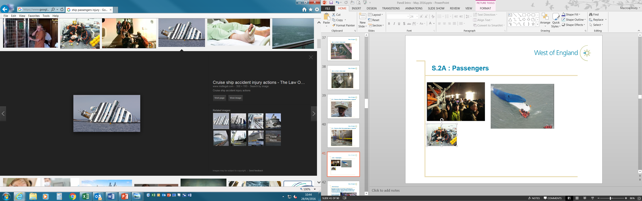
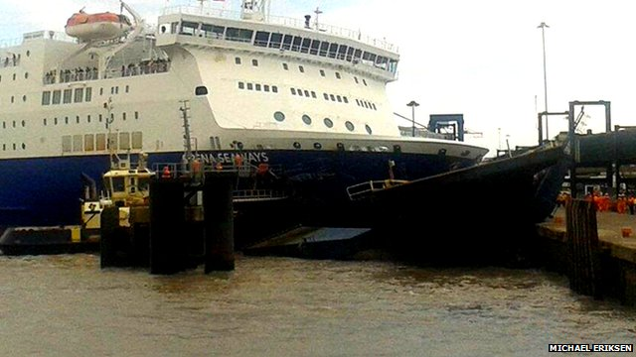
Passengers : Rule 2, Sections 2A and 5
Injury, illness and death
Repatriation
Deviation expenses
Compensation for delay and cancellation

Slide 12
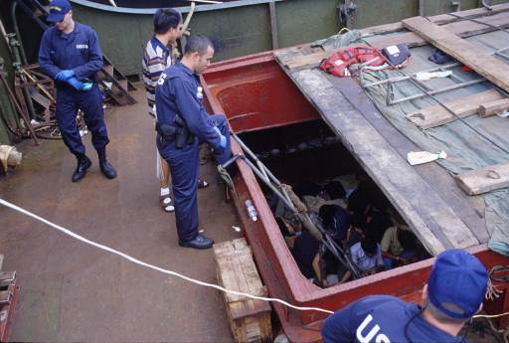
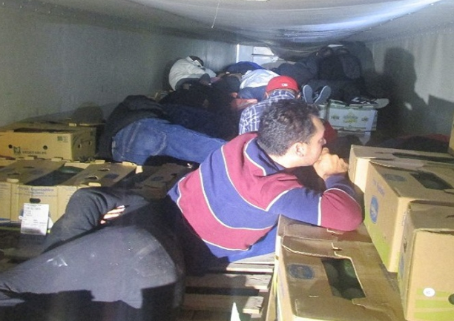
Stowaways : Rule 2, Section 6

Slide 13


Refugees and Life Salvage : Rule 2, Sections 6 and 7

Slide 14
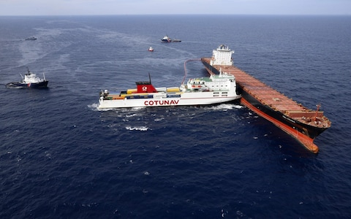
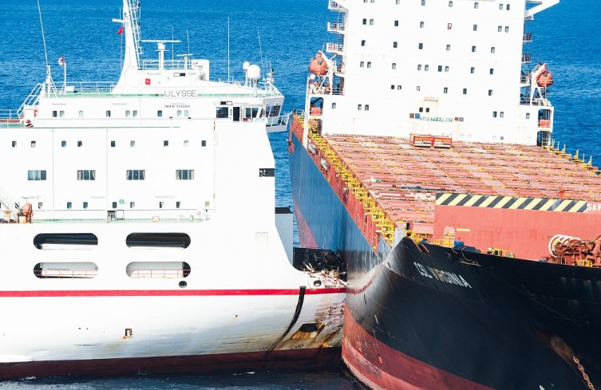
Collision : Rule 2, Section 9
Is it P&I or H&M?
1/4th verses 4/4th ?

Slide 15
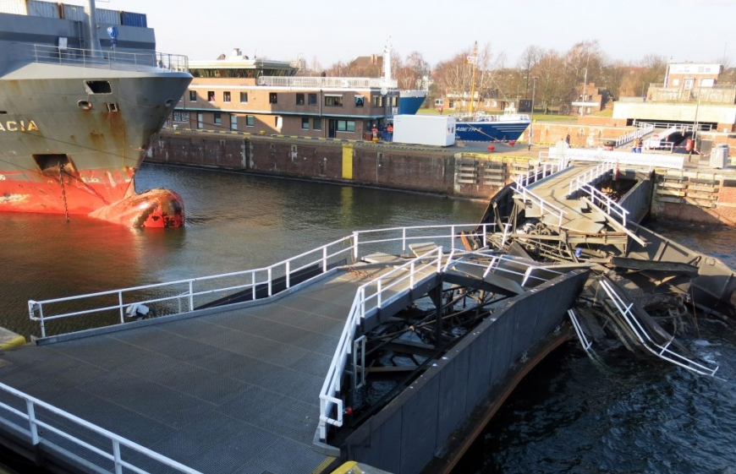
Fixed & Floating Objects : Rule 2, Section 10
eg: contact with lock gate

Slide 16
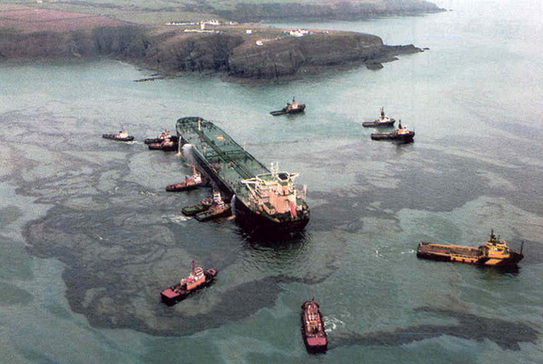
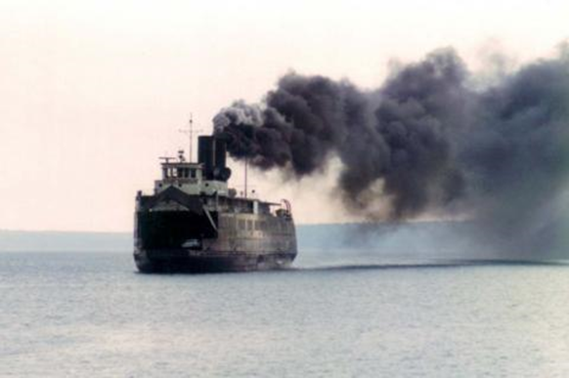
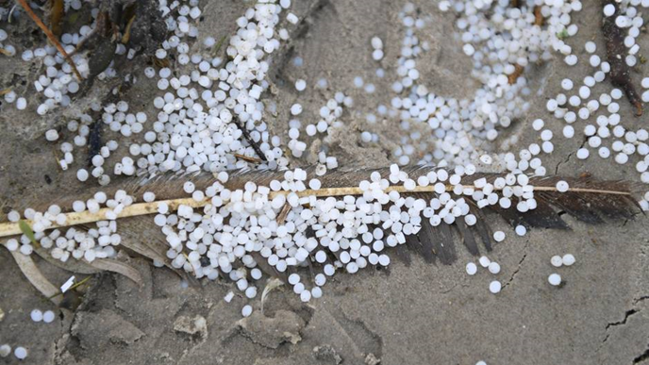
Pollution : Rule 2, Section 11
Two distinct areas of cover:
i) Indemnify Member
eg: Civil liabilities and expenses, fines etc.
ii) Direct Claims
ie: compulsory insurance regimes
eg: CLC, Bunkers Convention
and provision of “Blue Cards”

Slide 17
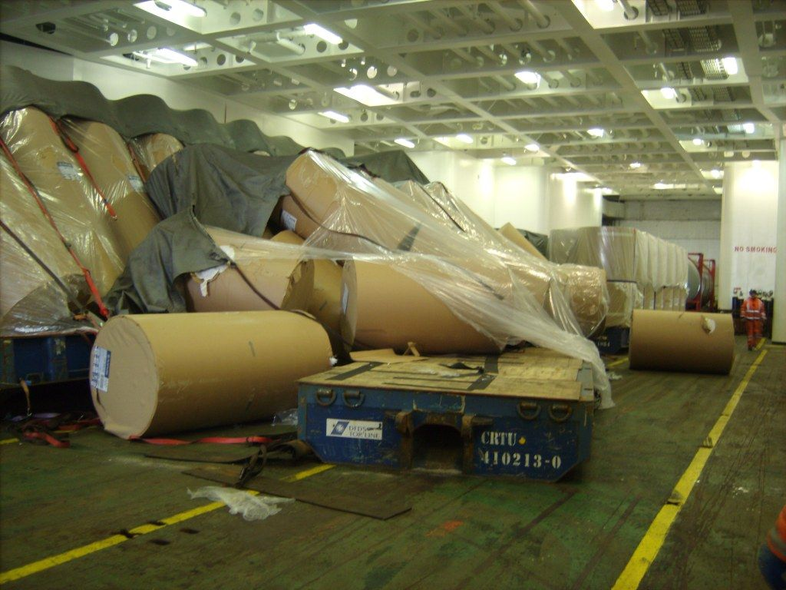
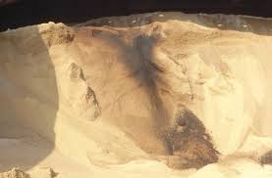
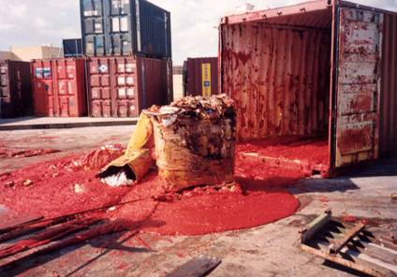
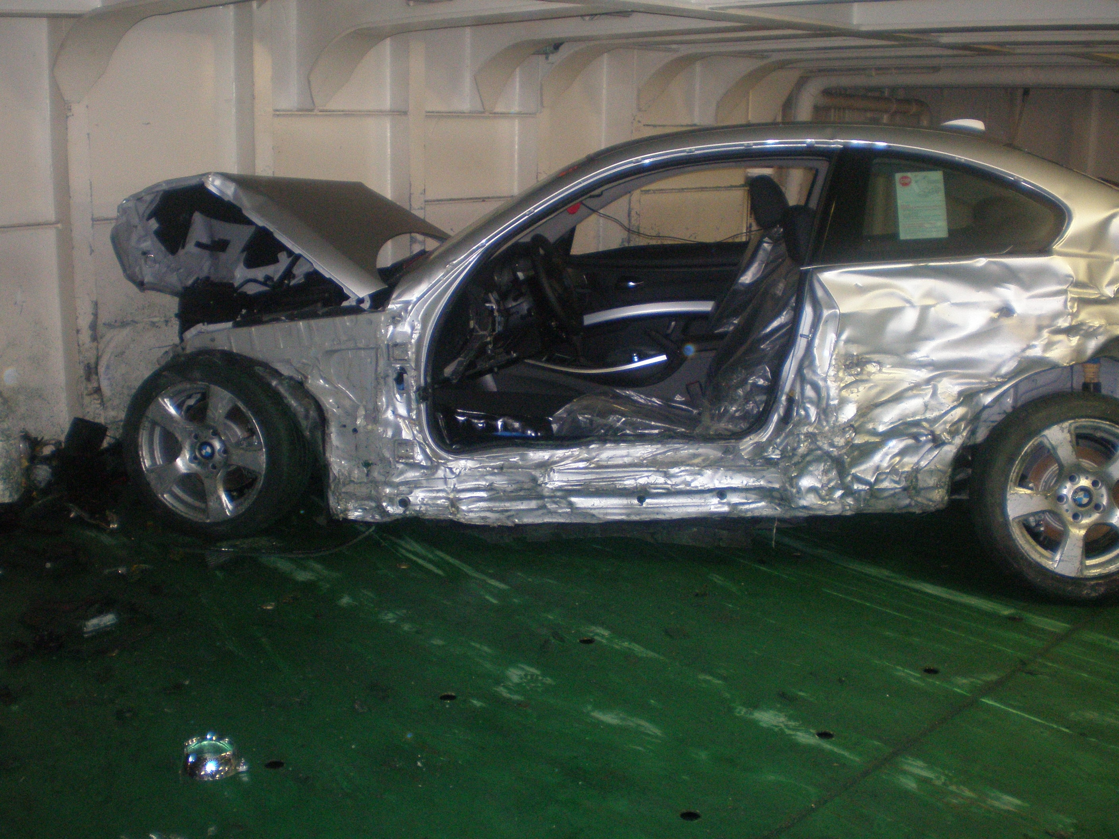
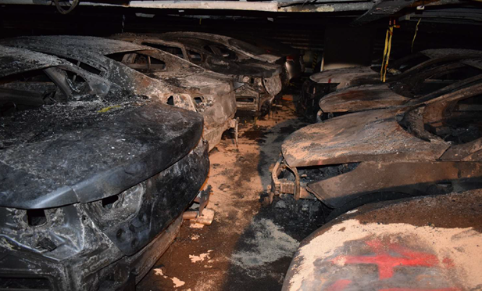
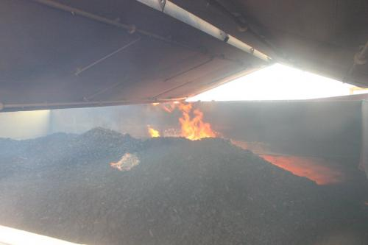
Cargo : Rule 2, Section 16
Loss including shortage or damage and disposal

Slide 18
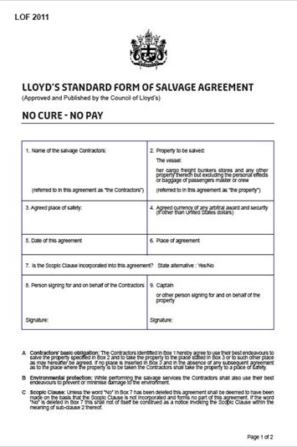
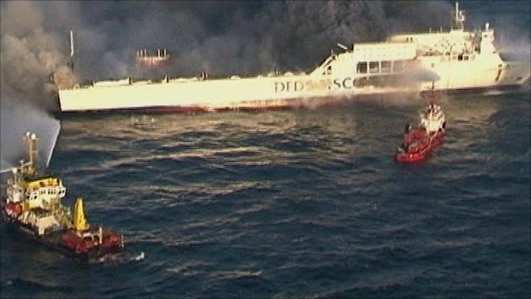
Salvage: Rule 2, Section 20

Slide 19
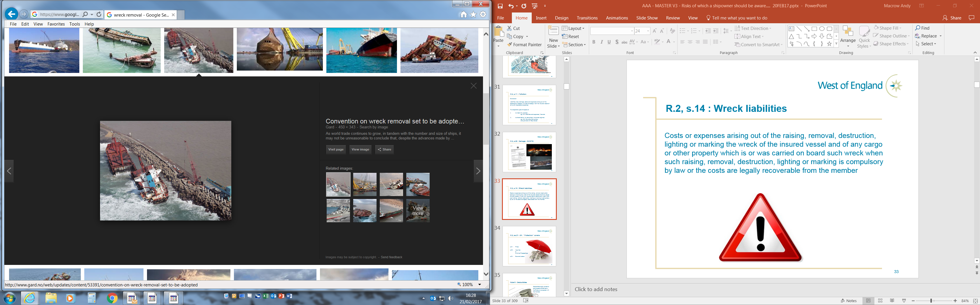

Wreck liabilities : Rule 2, Section 14
Costs or expenses arising out of the raising,
removal, destruction, lighting or marking of
the wreck of the insured vessel and of any
Cargo or other property which is or was
carried on board such wreck when such
raising, removal, destruction, lighting or
marking is compulsory by law or the costs
are legally recoverable from the Member.

Slide 20
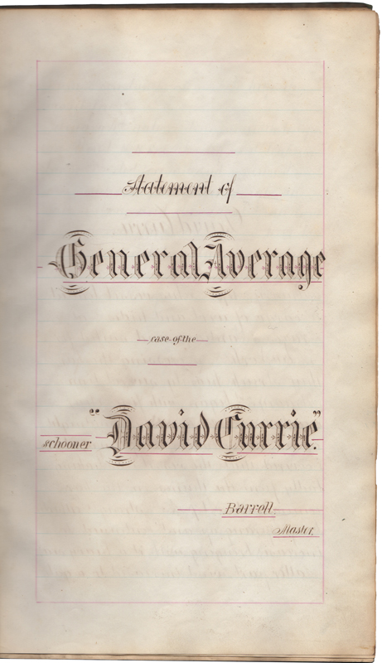
General Average: Rule 2, Sections 17 and 18
Contribution due from cargo or from some other party to
the marine adventure not legally recoverable by reason
only of a breach of the contract of carriage.
Owner’s contribution not recoverable under the Hull and
Machinery policies solely by reason of the sound value of an
insured vessel having been assessed at a value in excess of the
amount for which such vessel should have been insured.

Slide 21
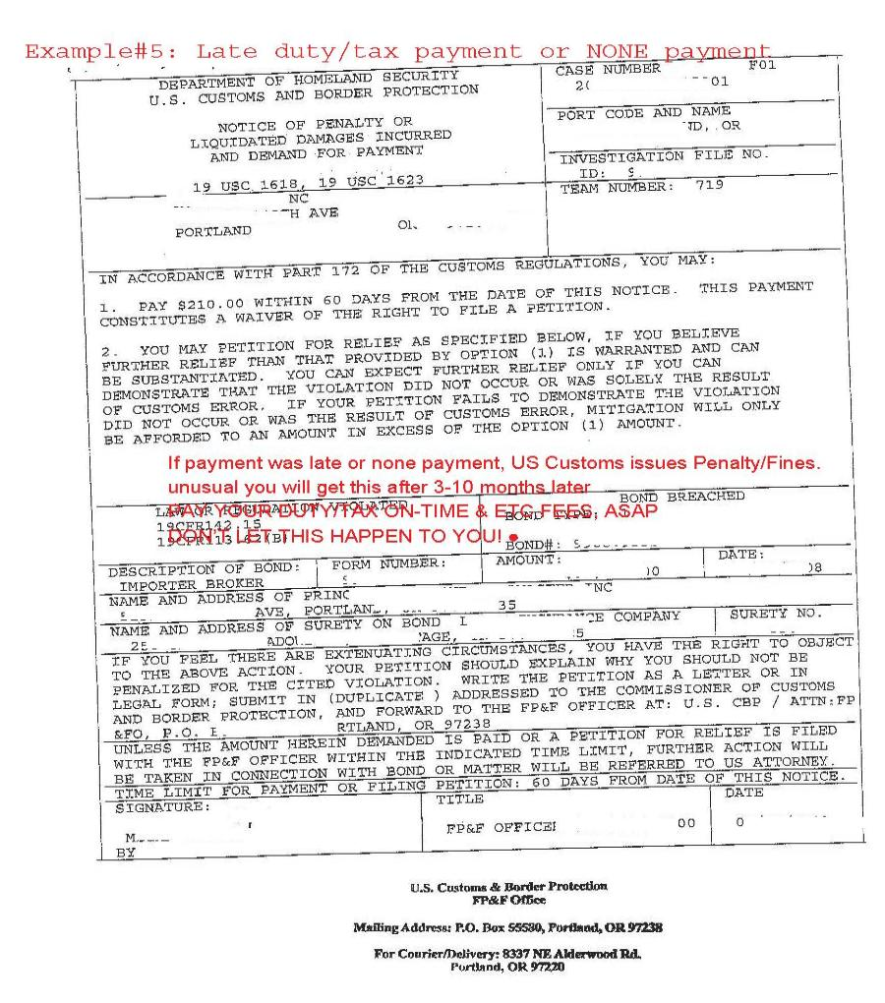
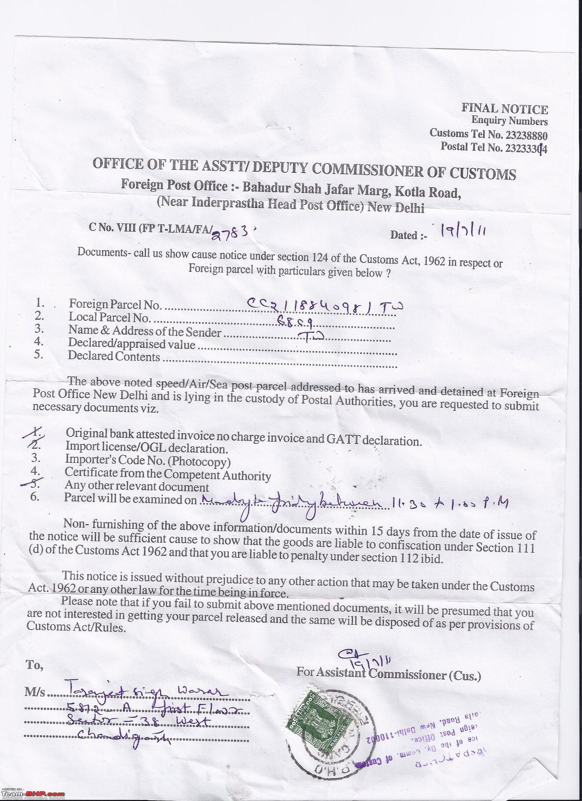


Fines: Rule 2, Section 21

Slide 22
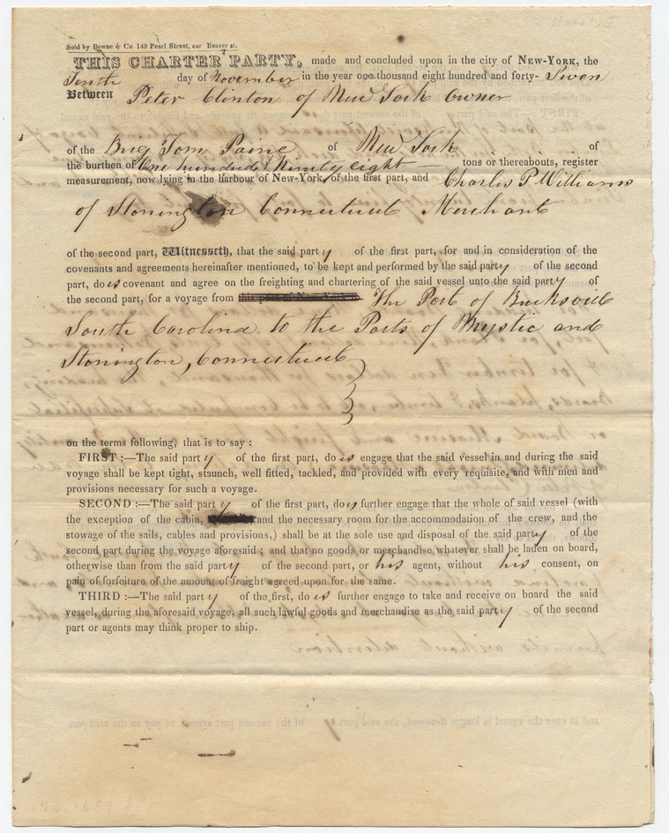
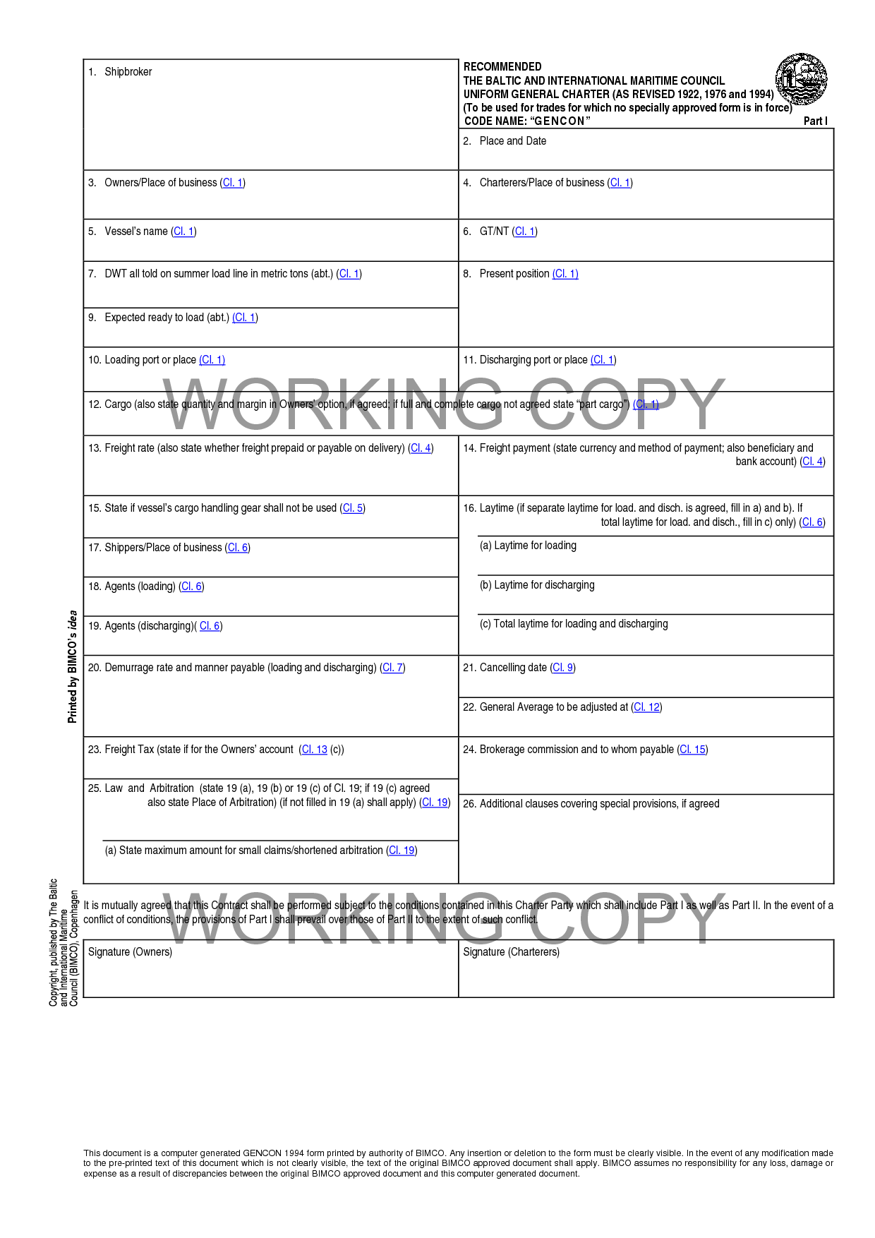
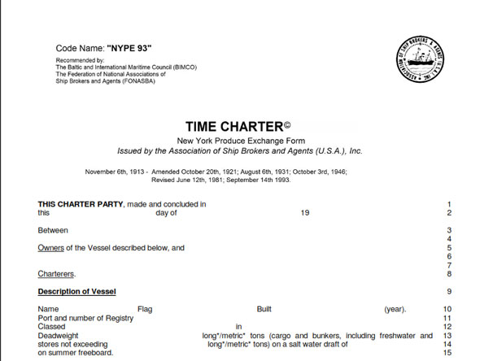
Charterers’ cover: Rule 3

Slide 23

Notification of Claims

Slide 24
Notification of claims etc : Rule 24
A Member must:
  promptly notify the Managers of every casualty, event or matter which is liable to give rise to a claim upon the Association and of every event or matter … which is liable to cause the Member to incur loss, damage, liabilities, costs or expenses for which he may be insured by the Association;
A Member shall not settle or admit liability for any claim for which he may be insured by the Association … without prior written consent of the Managers.
If a Member commits any breach of his obligations referred to in (1) or (2) above the Committee may determine to reject any claim by the Member against the Association arising out of the casualty, event or matter, or reduce the sum otherwise payable by the Association in respect thereof by such amount as it may determine

Slide 25
Time Bar : Rule 25
Without prejudice to the duty of prompt notification contained in Rule 24, if a Member:
(i) fails to notify the Managers of any casualty, event or matter referred to in Rule 24 within one year after he has knowledge thereof (or in the opinion of the Committee ought to have known thereof), or
(ii) fails to submit a claim to the Managers for reimbursement of any loss, damage, liabilities, costs or expenses within one year after discharging the same (in the case of an agreed settlement, after he receives the Managers’ approval for the settlement in accordance with Rule 24(2)),
the Member’s claim against the Association shall be extinguished and the Association shall be under no further
liability in respect thereof unless the Committee shall otherwise determine.
Without prejudice to paragraph (1) of this Rule, no claim shall in any event be recoverable from the Association
unless written notice thereof has been given to the Managers within three years from the time of the casualty
or other event or matter giving rise to the claim

Slide 26

Employment of Lawyers and others : Rule 26
…the Managers may at any and all times appoint and employ on behalf of a Member upon such terms as they may think fit lawyers, surveyors or other persons … for the purpose of dealing with any matter liable to give rise to a claim by the Member upon the Association….

Slide 27
Powers of the Managers : Rule 27
The Managers shall have the right if they so decide:
to control or direct the conduct of any claim or legal or other proceedings relating to any liability, loss, damage, costs or expenses in respect whereof a Member is or may be insured in whole or in part;
to require the Member to take any step in connection with the handling of such claim or proceedings which the Managers may think appropriate;
(c) to require the Member to settle, compromise or otherwise dispose of such claim or proceedings in such manner
and upon such terms as the Managers see fit.
If a Member does not settle, compromise, dispose of or take steps in connection with the handling of a claim or
proceedings as required by the Managers in accordance with paragraph (1) of this Rule, any eventual recovery by the
Member from the Association in respect of such claim or proceedings shall be limited to the amount he would have
recovered if he had acted as required by the Managers.

Slide 28
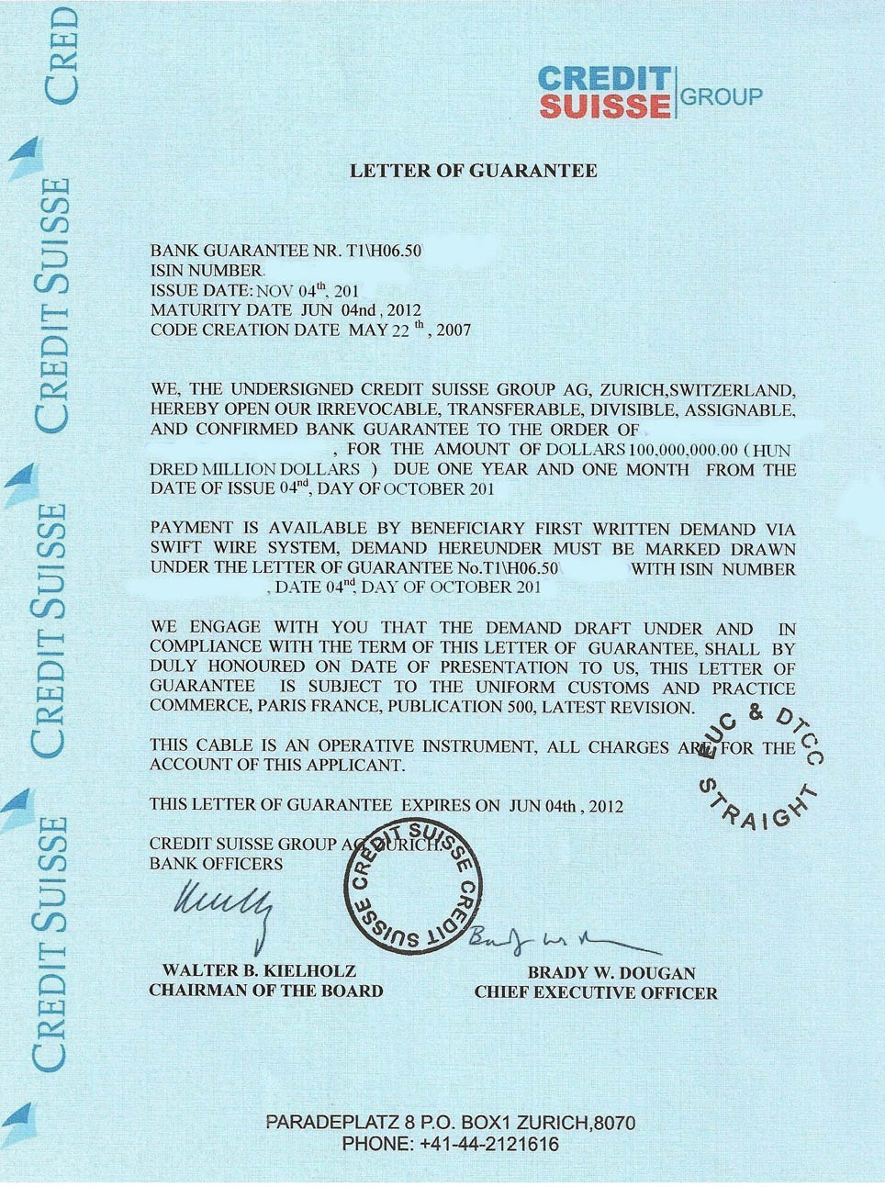
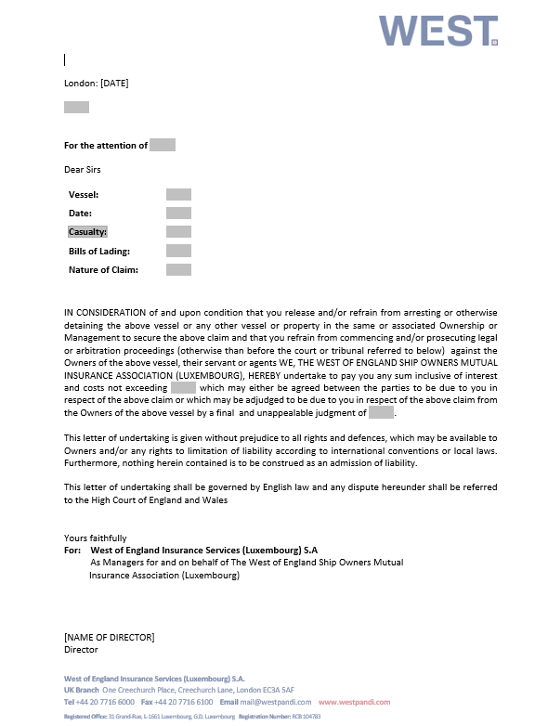
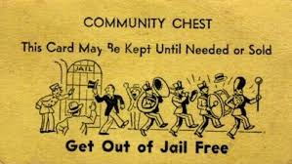
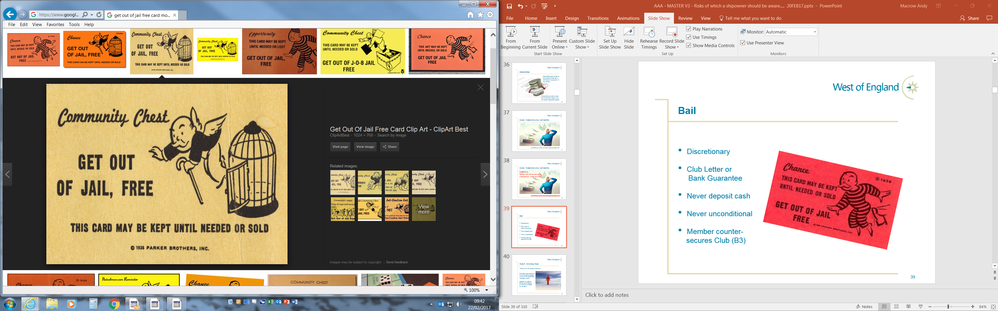
Bail : Rule 28
Club Letter or
Bank Guarantee
Discretionary
Never cash deposit
Never unconditional

Slide 29

Thank you

